Slide 2
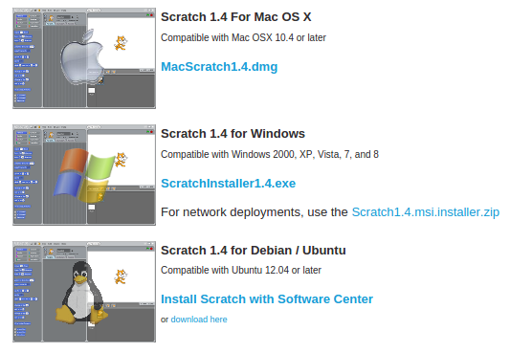
Install Scratch
Go to => http://scratch.mit.edu/scratch_1.4/

Slide 3
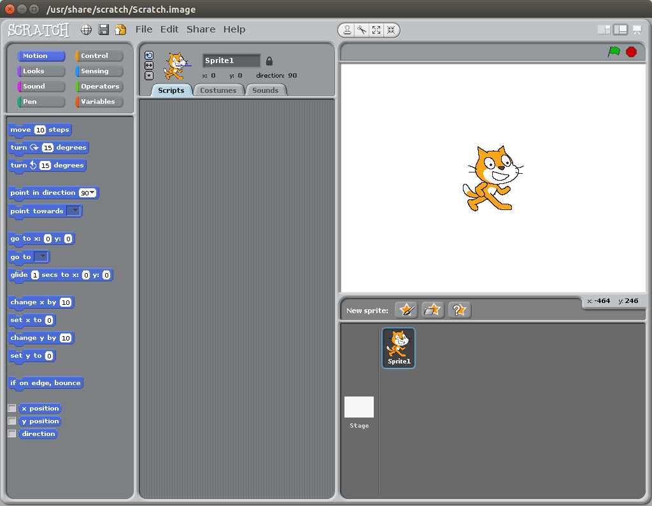

Slide 4
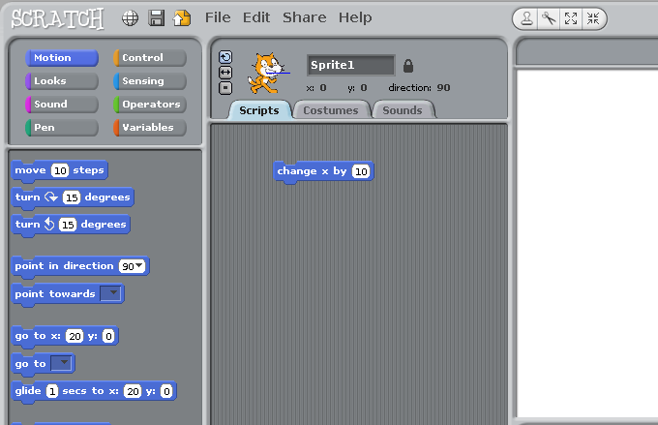
Drag 'change x by 10' to the middle area

Slide 5
Double click on 'change x by 10' what happens ?

Slide 6
Now add another 'change x by 10'. Not too close or they will stick. click on the number and change it to say -10 and double click on that. Try both a few times. What happens ?

Slide 7
If your cat escapes try this button - What does it do ?

Slide 8
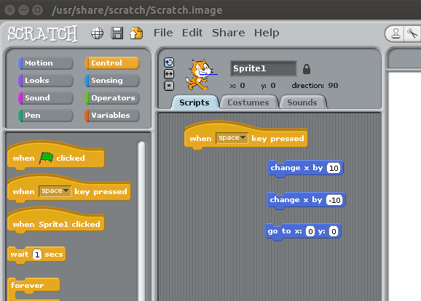
Select the orange ‘Control’ button in the top left and drag
'when space is pressed' button on onto the main area.

Slide 9
Pick up the existing 'change x by 10’ and stick it to the bottom of the new button – note it gets a white line when it is close enough to stick.

Slide 10
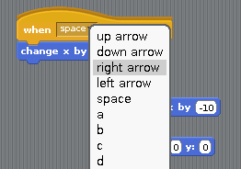
Click on the little arrow next to 'space' and from the drop down menu select ‘right arrow’.

Slide 11
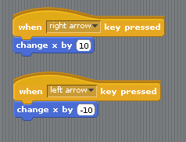
Drag out another 'when space key pressed' button from the left. Change this one to 'left arrow' and attach the ‘change x by -10’ button

Slide 12
What do your left and right keys do now ? Why ? What do the up and down keys do ? Why ?

Slide 13
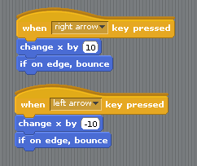
Click on the 'Motion' button in the top left and add two new commands 'if on edge bounce'. What difference does this make you you hit the sides?

Slide 14
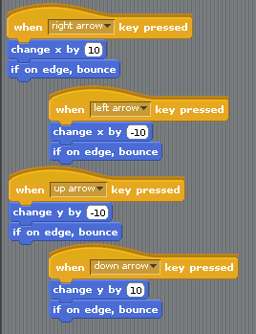
Picking the items from Control and Motion, add two more sets. This time pick 'Change Y by 10' and remember to change one to '-10'

Slide 15
Move round again. Do the Up and Down keys work now ? Are they correct ? Why not ? How do you fix it ?

Slide 16
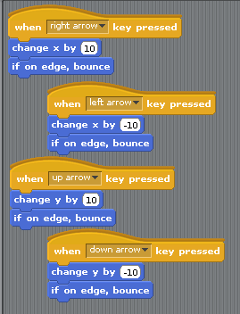
Make the up one read ‘10’ and the down one read ‘-10’

Slide 17
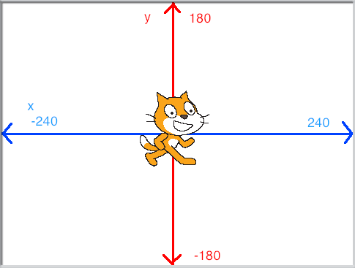
The Blue line shows you 'X' or how far left and right the cat is. The Red line shows you 'Y' or how far up and down the cat is.

Slide 18
If the numbers go from -180 to 180 or from -240 to 240, then what two numbers are right in the middle ?

Slide 19
X is 0 and Y is 0

Slide 20
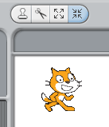
We need some more room. Make the cat smaller by clicking on the four arrows that are pointing at each other and the clicking on the cat about 20 times (not too many or he will shrink away to nothing)

Slide 21
Every game needs a bad guy !
Pick the yellow star icon in the middle with the grey folder over it.

Slide 22
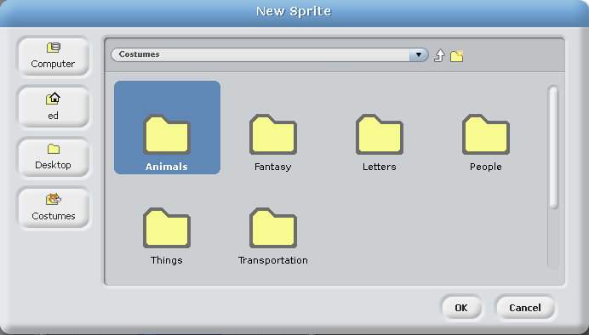
Double click on Animals...and...

Slide 23
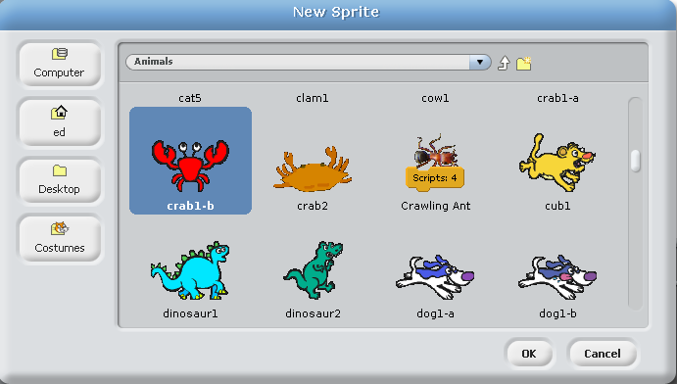
Pick the crab1-b (You'll see why I picked this one in a bit)

Slide 24
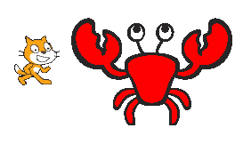
Ekkk ! Thats a big crab.
Shrink him down with about 25 clicks from the shrinking arrows.

Slide 25
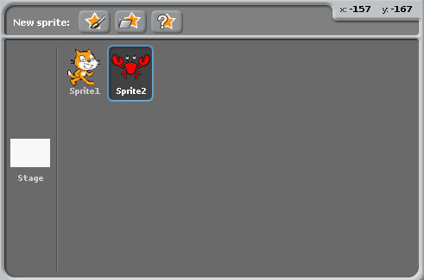
Click on each ‘sprite’ in the bottom right corner. See how the middle code window changes. Each sprite has its own commands and jobs to do.

Slide 26
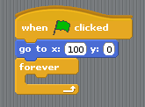
Now we need the crab to move. Click on it down in the bottom right where it says ‘sprite 2’ and add these items. Change the X and Y numbers to 100 and 0

Slide 27
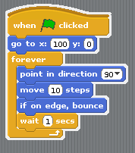
The ‘Forever’ command is called a loop. This is something we want to repeat over and over again, in this case forever.
Place these things inside the gap (the colour lets you know where to find them in the button areas on the left):

Slide 28
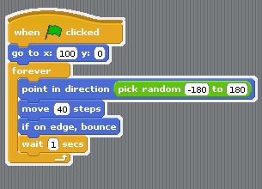
In the green ‘Operators’ pick up ‘Pick random’ and put it down over the ‘90’ in direction. Set the values to ‘-180’, ‘180’ and ‘40’ for steps to take

Slide 29
If you click on the Green flag you start the game. The Red circle stops the game (this is useful if it is going a bit crazy)

Slide 31
How about getting the cat back to his starting place when the green flag is clicked ? How would you do that ?
?

Slide 32
Click on ‘sprite 1’ down at the bottom so you are working on his code and not on the crab. Now add this :
Now they both have commands to do when the green flag is clicked.

Slide 33
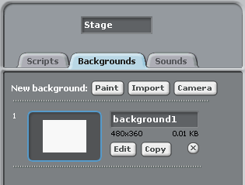
It looks a little dull. We need a background picture.
Click on the white square next to the sprites that says ‘stage’. This is the window you are working in. Now click ‘backgrounds’ and ‘import’

Slide 34
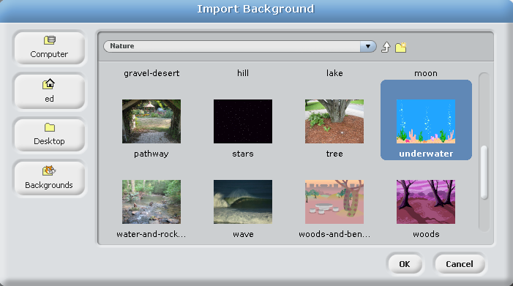
Select ‘Nature’ and then go down and select ‘Underwater’

Slide 35
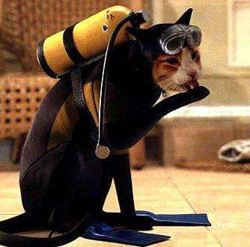
Hang on ! Cats don’t go under water ?!?!?!?

Slide 36
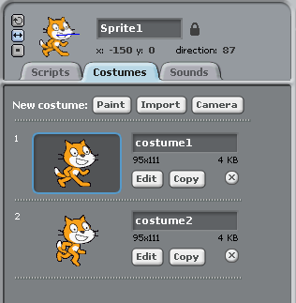
Click on ‘sprite 1’ and then on Costumes and Import :

Slide 37
Pick Animals again and ‘Starfish-1a’

Slide 38
It is probably a good time to hit ‘SAVE’ (The picture of the disk)
and give your new game a name. How about ‘WaterWorld’

Slide 39
At the moment your game doesn’t do anything.
Lets give it something to do :)
Click on ‘sprite1’ and on ‘scripts’ so we can see the cat… Errr I mean the starfishes commands again. You should already have this bit of code - we are going to add to it :

Slide 40
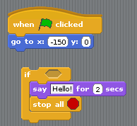
The ‘if’ and ‘stop all’ commands are in ‘Control’
The ‘say Hello for 2 seconds’ command is in ‘Looks’
Place them just below at the moment - do not put them onto the other bit

Slide 41
The ‘If’ bit is saying :
If something happens then do this bit.
The bit inside will only get done when the thing happens.
Next change the ‘Hello!’ writing to ‘Game Over’

Slide 42
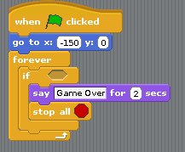
We need to check if the game is over all the time - so we will
need to put this inside another loop so it happens again and again and
again and again…...and again…..and…...

Slide 43
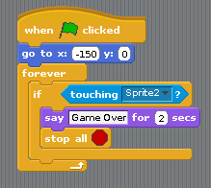
In the ‘Sensing’ button area there is an item that says ‘touching ?’. Drop this into the little hole in the ‘if’ box and then using the drop down menu pick ‘sprite 2’
So we are now saying - If sprite 1 (thats our starfish) touches sprite 2 (Thats the evil crab) then <*** game over ***>

Slide 44
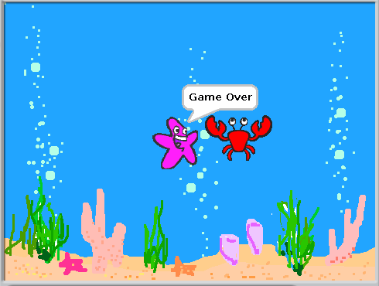
Save it and Test it (click the green flag)

Slide 45
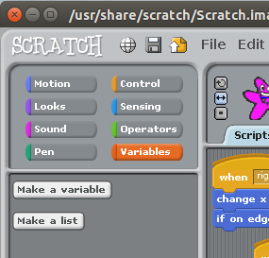
Lets add ‘lives’ to our starfish.
Click on ‘Variables’ and ‘Make a Variable’

Slide 46
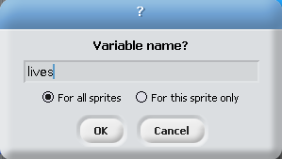
Type in its name ‘lives’ and press OK
A variable is a bit like a ‘box’ with a name on it
We now have a box called ‘lives’ and we are going to put a number
into that box. How many lives shall we give our starfish ?

Slide 47
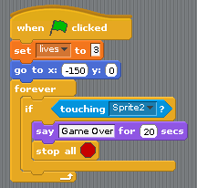
Make sure you have sprite1 (the starfish) selected and pickup ‘set lives to 0’ and drop it into the bit of code that has the green flag on top.
Now when you start the game it will set the lives. It puts that number into our variable (or box called ‘lives’) Remember to change the number - we don’t start with 0 lives.

Slide 48
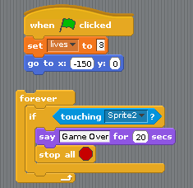
Pick up the ‘forever’ loop and take it off the bit of code it is on.
We need to swap it for a slightly more clever version ‘repeat until’
This new one will loop but only if something is right -
in this case ‘loop if the starfish is still alive then drop out of the loop’

Slide 49
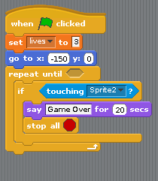
The loop is now changed - it used to run ‘forever’ now it runs ‘forever if’.
If you want to get rid of the old one pick up up and drop it back on the left
We have a few more changes to make and then we can test...

Slide 50
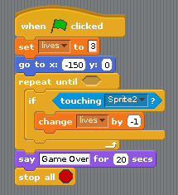
Move the ‘say Game Over’ and ‘stop’ bits out to the bottom - we only want this to happen at the end when all the lives are gone.
In the gap, go to ‘variables’ and add ‘change lives by 1’ and then set the number to be ‘-1’ (otherwise he gains a life each time)

Slide 51
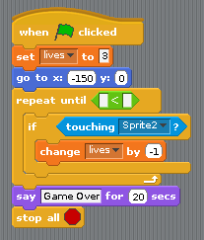
We need to check something to tell us to break out of the loop that runs during the game. Click on the operators button and add in the green command below :

Slide 52
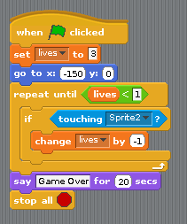
In Variables pick ‘lives’ and in the other box put ‘1’
This means do the game loop until lives is less than ‘1’
He dies when his lives are less than 1 (or zero in this case)

Slide 53
If you have not done it for a while -
you should probably hit ‘SAVE’
Then run and see how it works

Slide 54
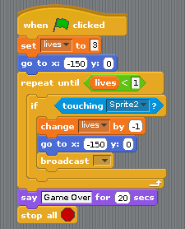
There is a good change starfish died on the first hit.
What happens is he loses a life but then then he is still touching the crab so he drops another life and another and ….
We need to send the two of them back to their starting points.

Slide 55
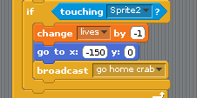
We have added a ‘broadcast’ to the starfish, clicked on the arrow and on ‘new’ and named it ‘go home crab’

Slide 56
And now click on the sprite2 icon down in the bottom right and add this code to crab :

Slide 57
What have we used today ?
Loops
Variables
‘If’

Slide 58
Thats it - you have just coded your first game.
Does that make you a CoderDojo Ninja ?

Slide 59
No.

Slide 60
A CoderDojo Ninja is someone who takes it further and
makes it into their own unique game.
Some ideas :
* What about different graphics ? Where else could you set it ?
* Sound FX - it is a bit quiet
* The evil guys movement is pretty bad - how could it be better.
* Maybe we need 2 evil guys… or 3… or 20 :)
* What about good guy seeking bad guys, so they follow you?
* Food that shows up for a few seconds to give you back lives.
(what DO starfish eat ?)
* Things that block the path so you need to go round them.
* and most important… add your own ideas...

Slide 61
A big thank you to
The Donabate Dojo Mentor team.
The Community Centre for the room and setting it up.
The mums and dads and adults for transport and help
and most of all - Thank you to our new Ninjas (thats you)
Comments, suggestions, donations, questions to :
email : team@donabateDojo.com
Facebook : www.facebook.com/DonabateDojo
Twitter :@DonabateDojo
Website : www.donabateDojo.com

