Slide 2
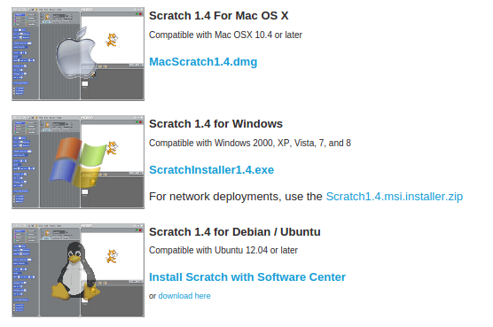
Install Scratch
Go to => http://scratch.mit.edu/scratch_1.4/

Slide 3
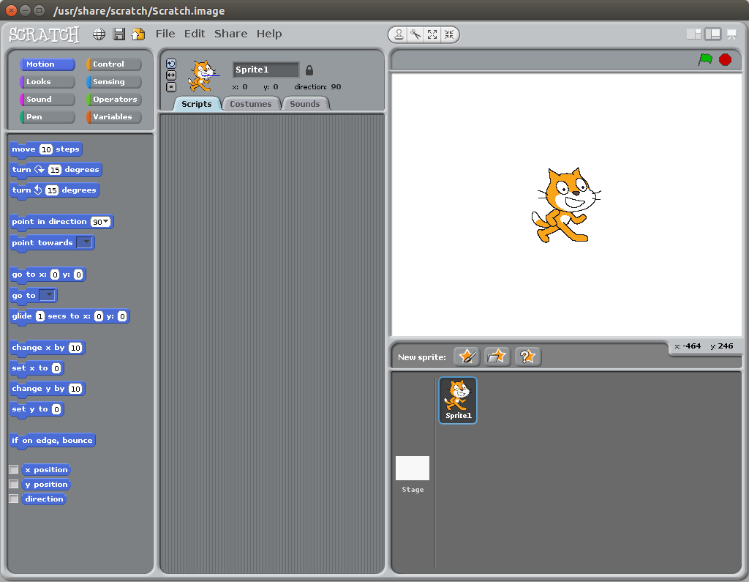

Slide 4
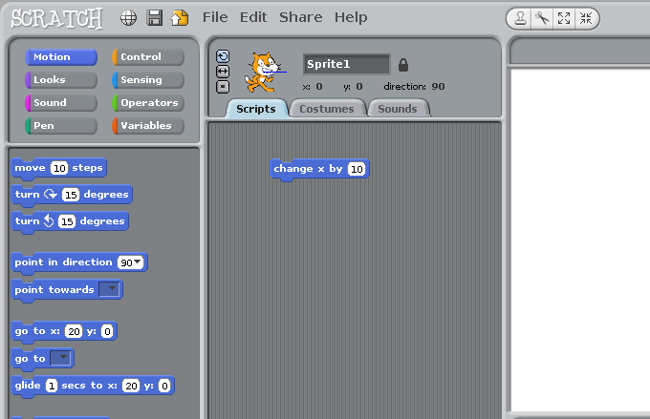
Drag 'change x by 10' to the middle area

Slide 5
Double click on 'change x by 10' what happens ?

Slide 6
Now add another 'change x by 10'. Not too close or they will stick. click on the number and change it to say -10 and double click on that. Try both a few times. What happens ?

Slide 7
If your cat escapes try this button - What does it do ?

Slide 8
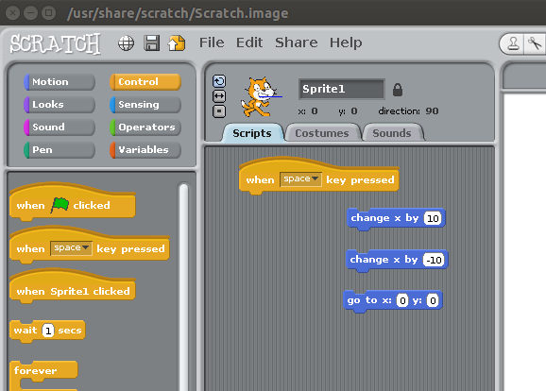
Select the orange ‘Control’ button in the top left and drag
'when space is pressed' button on onto the main area.

Slide 9
Pick up the existing 'change x by 10’ and stick it to the bottom of the new button – note it gets a white line when it is close enough to stick.

Slide 10
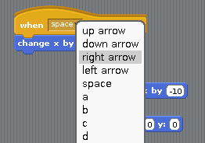
Click on the little arrow next to 'space' and from the drop down menu select ‘right arrow’.

Slide 11
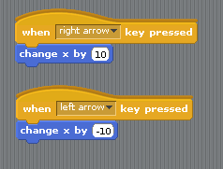
Drag out another 'when space key pressed' button from the left. Change this one to 'left arrow' and attach the ‘change x by -10’ button

Slide 12
What do your left and right keys do now ? Why ? What do the up and down keys do ? Why ?

Slide 13
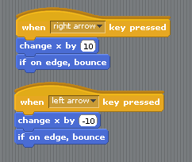
Click on the 'Motion' button in the top left and add two new commands 'if on edge bounce'. What difference does this make you you hit the sides?

Slide 14
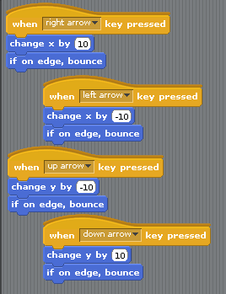
Picking the items from Control and Motion, add two more sets. This time pick 'Change Y by 10' and remember to change one to '-10'

Slide 15
Move round again. Do the Up and Down keys work now ? Are they correct ? Why not ? How do you fix it ?

Slide 16
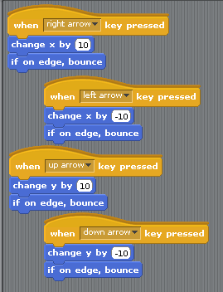
Make the up one read ‘10’ and the down one read ‘-10’

Slide 17
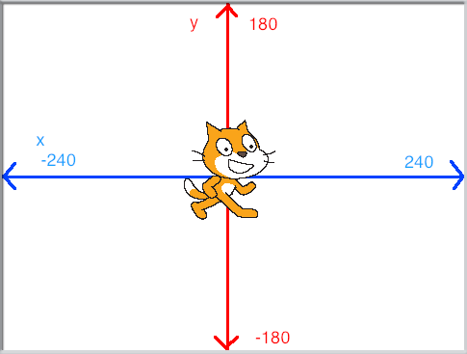
The Blue line shows you 'X' or how far left and right the cat is. The Red line shows you 'Y' or how far up and down the cat is.

Slide 18
If the numbers go from -180 to 180 or from -240 to 240, then what two numbers are right in the middle ?

Slide 19
X is 0 and Y is 0

Slide 20
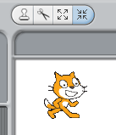
We need some more room. Make the cat smaller by clicking on the four arrows that are pointing at each other and the clicking on the cat about 30 times (not too many or he will shrink away to nothing)

Slide 21
It is a good idea to save your game now and then so you can always go back if it gets messed up or even goes wrong and crashes.
Click ‘save’ icon and type in a name.
Lets call this one road-rage

Slide 22
Time to change our cat. Click on the cat in the sprite area then click on costumes and import (just above the program area)

Slide 23
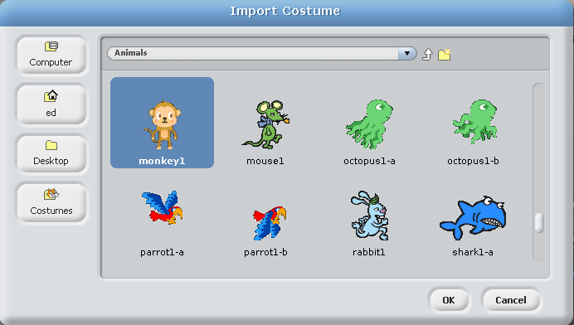
Select ‘Animals’ and then pick ‘monkey1’

Slide 24
Give it a name ‘monkey’ and select the middle button - this stops him spinning round and round when he moves

Slide 25
Now lets add some more sprites…
click on the star with the grey folder in front of it

Slide 26
Select ‘Transportation’ and ‘car1’
Make it smaller by about 30 clicks
name it ‘car1’

Slide 27
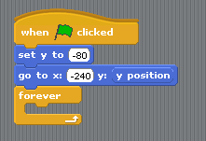
Lets add some code to make the car do something (like move)
You will find the yellow ones in ‘control’ and the blue ones in ‘motion’
The second blue command is made up of two different things.
First get ‘go to X: [ ] and Y: [ ] and then pick up ‘y position’ at the bottom and drop it in the second box. Remember to update the other numbers to match :

Slide 28
The ‘forever loop’ will keep repeating whatever is inside it over and over and over again.

Slide 29
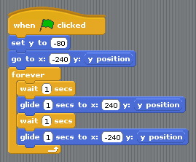
Fill up the ‘forever loop’ with these items Remember to set the values to the same (and note the bottom X: value says -240)

Slide 30
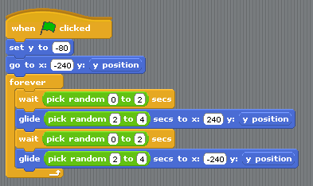
In the ‘operators’ green button you will find ‘pick random [1] to [10]’ Pick this up and put it in place of each ‘1’
Change the values to match :

Slide 31
If you have not done it for a while -
you should probably hit ‘SAVE’

Slide 32
Now lets test again. Click the green flag. What happens now ?

Slide 33
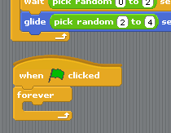
Still in the car - lets add another bit of code. Start a new block below the one you just made by grabbing a new item and just dropping it further down :

Slide 34
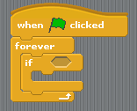
This one will have another ‘forever loop’ -
so it does what is inside that over and over. Inside that loop we have an ‘IF’. That means that it will only run the bit inside that ‘if’ something happens.

Slide 35
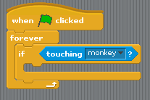
From the blue ‘sensing’ area pick up ‘touching [ v]’
Click on the down arrow and select ‘monkey’
Now what happens if a car touches a monkey ?

Slide 36
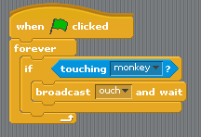
From the ‘control’ area pick up ‘broadcast [ v] and wait’
Click on the down arrow and select ‘new’
Call the broadcast ‘ouch’

Slide 37
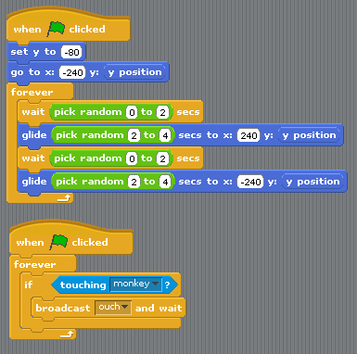
If all has gone well, you should now have :

Slide 38
If you have not done it for a while -
you should probably hit ‘SAVE’

Slide 39
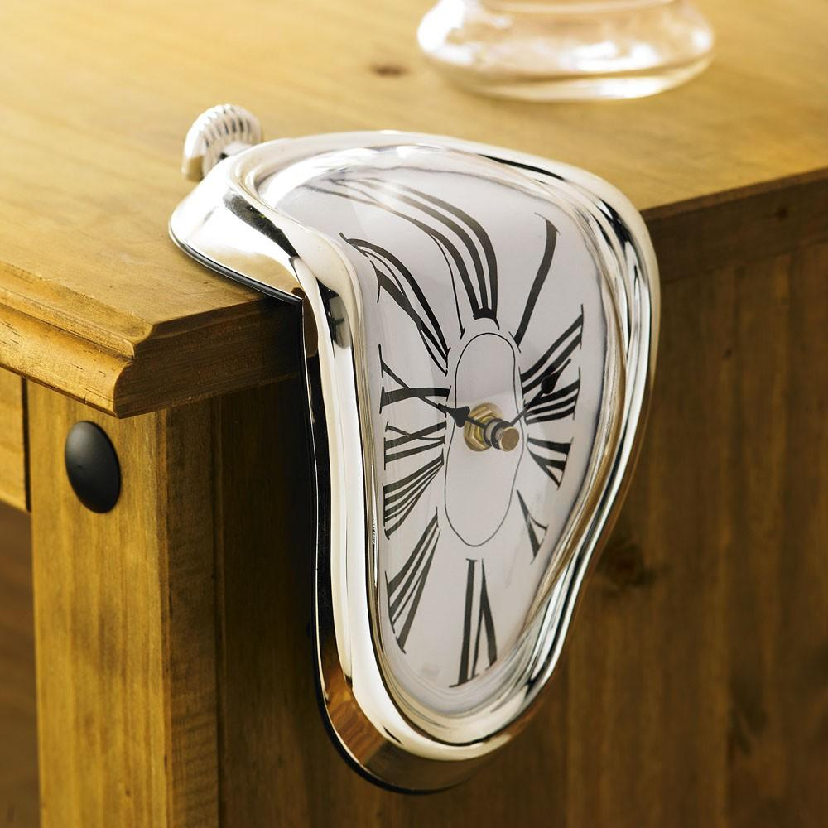
Break time… take 5 minutes. Rest your eyes, legs, fingers and all that.
Have a drink and a snack - keep up the energy levels - we have a LOT more work to do...

Slide 40
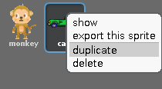
Right click on the car in the sprites area and select ‘duplicate’ If you have an Apple Mac it may be CTRL and click.
Call this sprite ‘car2’
now do it again and call it ‘car3’ and one more time ‘car4’

Slide 41
When you have done all four :

Slide 42
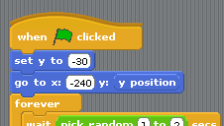
Each car has the same code you have already written - but you need to make a minor change. Go to car 2 and change the value ‘set y to’ to be -30
So now - Car 1 = -80 Car 2 = -30 Car 3 = 20
and Car 4 = 70

Slide 43
Lets add something to make our monkey a bit hungry. Add a new sprite (the star with the grey folder) and click ‘things’ and ‘banana1’ Shrink it about 30 clicks
and move it to the top middle of the screen Somewhere about X:0 and Y: 155 remember to rename it to ‘bananas’

Slide 44
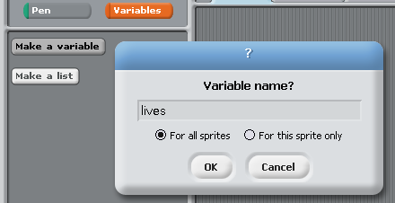
Click on the Variables button (in later version of scratch is is called ‘data’)
Click ‘make a variable’ and call it ‘lives’. The option below the name stays as ‘For all sprites’
A Variable is like a box with a name on the side (in this case it has ‘lives’ written on it) and it can contain things like numbers.
3
Lives

Slide 45
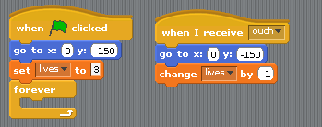
Click on the monkey in the sprite area and add some more code.
This is the bit that deals with his lives and the game ending. Add two bits of code. When you come to the ‘lives’ lines - these are the ones we just created in variables.

Slide 46
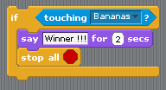
First lets test to see if the monkey touches the bananas.
Make this as another new bit of code :
(the purple bit is in ‘looks’)

Slide 47
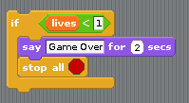
...and what about if things are not going so well and we have lost our lives ?

Slide 48
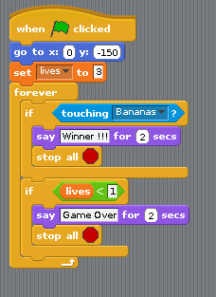
and now combine all these bits of code into one block like this :

Slide 49
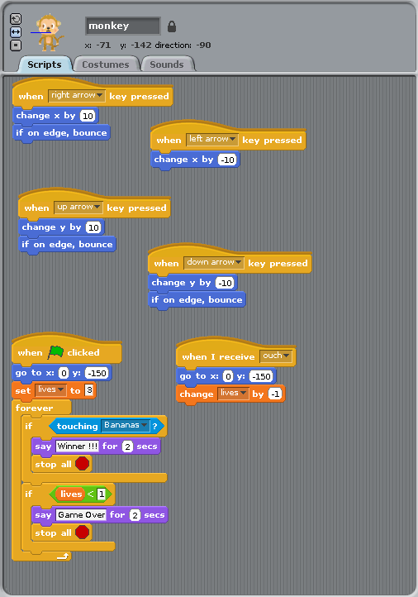
Your monkey should now have all this code :

Slide 50
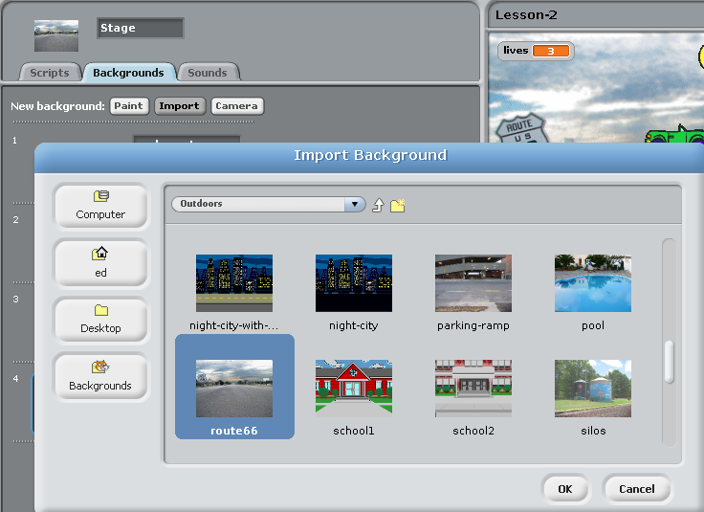
One last step… lets make the background look nice.
In the sprites area, click on the white box that says ‘stage’.
Click on backgrounds and Import.
Select ‘Outdoors’ and ‘route66’

Slide 51
If you have not done it for a while -
you should probably hit ‘SAVE’

Slide 52
Now lets test again. Click the green flag. What happens now ?
Is it fully working yet ?

Slide 53
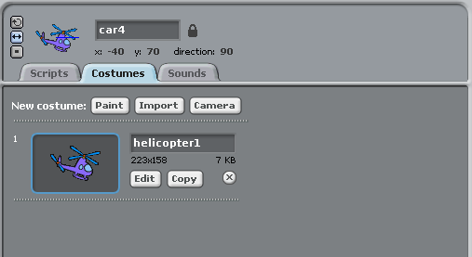
Hmmmm… car4 was a little ‘up in the air’.
How about if we select it, click ‘costumes’ and ‘Import’
then select ‘transport’ and ‘helicopter1’
Yes thats a bit more like it :)

Slide 54
What have we used today ?
Loops
Variables
‘If’

Slide 55
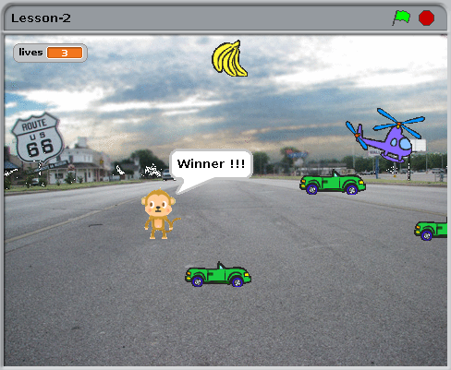
Thats it - you have just coded your first game.
Does that make you a CoderDojo Ninja ?

Slide 56
No.

Slide 57
A CoderDojo Ninja is someone who takes it further and
makes it into their own unique game.
Some ideas :
* What about different graphics ? Where else could you set it ?
* Sound FX - make some NOISE !!!
* More cars ? planes ? Trucks ? Ice-cream vans ?
* Things that block the path so you need to go round them.
* What about moving the bananas every 20 seconds ?
* and most important… add your own ideas...

Slide 58
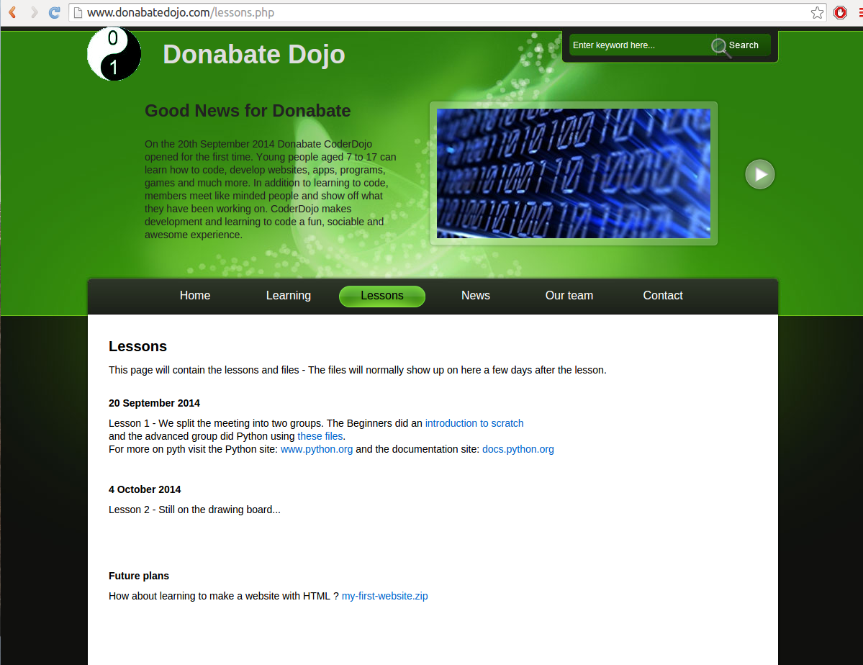
Did you miss any steps ? This presentation is available on our website :www.donabateDojo.com
Click on ‘lessons’

Slide 59
A big thank you to
The Donabate Dojo Mentor team.
The Community Centre for the room and setting it up.
The mums and dads and adults for transport and help
and most of all - Thank you to our new Ninjas (thats you)
Comments, suggestions, donations, questions to :
email : team@donabateDojo.com
Facebook : www.facebook.com/DonabateDojo
Twitter :@DonabateDojo
Website : www.donabateDojo.com

