Slide 2
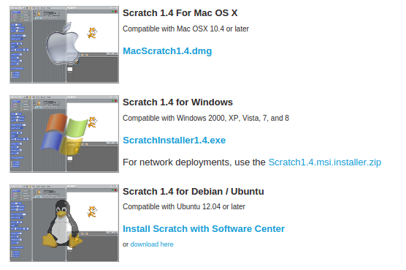
Install Scratch
Go to => http://scratch.mit.edu/scratch_1.4/

Slide 3
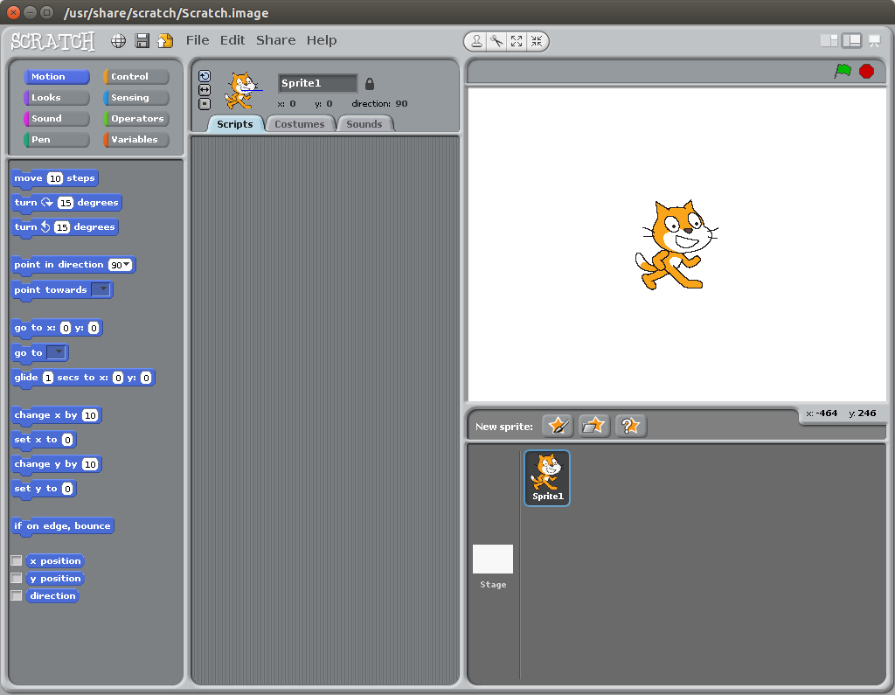

Slide 4
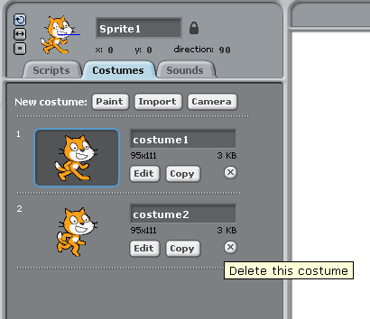
Today we will work on changing costumes. Start by clicking on ‘costumes’.
We only need the top one so click on the ‘X’ next to the bottom cat to delete it.
Please note - The design and idea for this game are borrowed from Al Sweigart http://scratch.mit.edu/projects/11629018/ (big thank you)

Slide 5
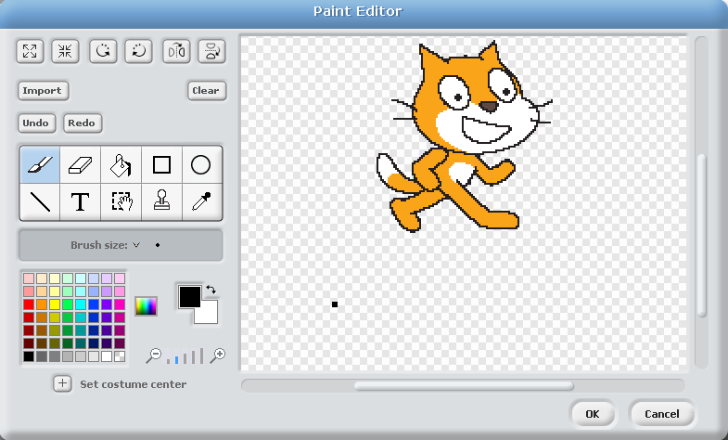
Click on ‘edit’ and move the cat up to the top of the screen using the scroll bar on the right.

Slide 6
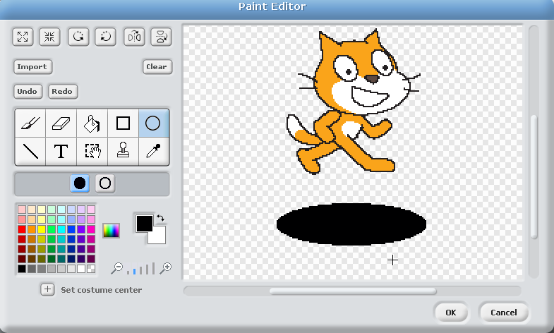
Select the circle and draw a flat circle under the cat.
Start by the arrow on the left and press and hold the left mouse button. Move down to the arrow on the right and let go.
If you get it wrong click ‘undo’ and try again.

Slide 7
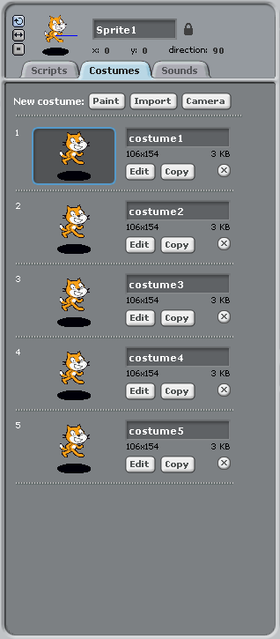
Click ‘Copy’ 4 times so we end up with 5 cats. If you do it too many times click the ‘X’ to remove the spare ones.

Slide 8
It is a good idea to save your game now and then so you can always go back if it gets messed up or even goes wrong and crashes.
Click ‘save’ icon and type in a name.
Lets call this one Whack-a-Cat

Slide 9
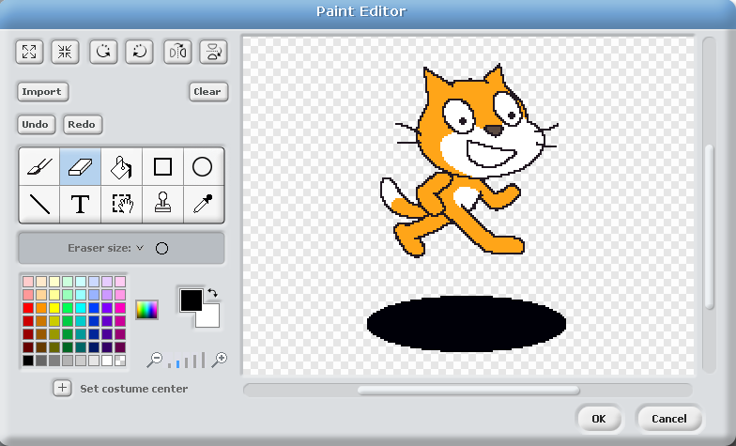
Click on the top cat and click ‘edit’.
Click on the ‘select tool’. This will allow us to draw a box round an area we are interested in changing.

Slide 10
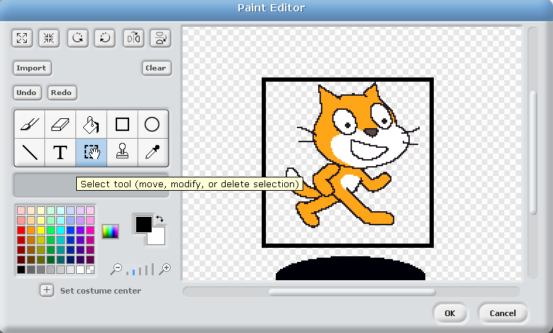
Draw a box round all of the cat but NOT round the circle.
If it goes wrong - click on the tool again and you can try again.
If it really goes wrong click ‘undo’.

Slide 11
Press the DEL key on your keyboard.
If it goes right and looks like this press OK.
If it goes wrong - hit cancel and then try again.

Slide 12
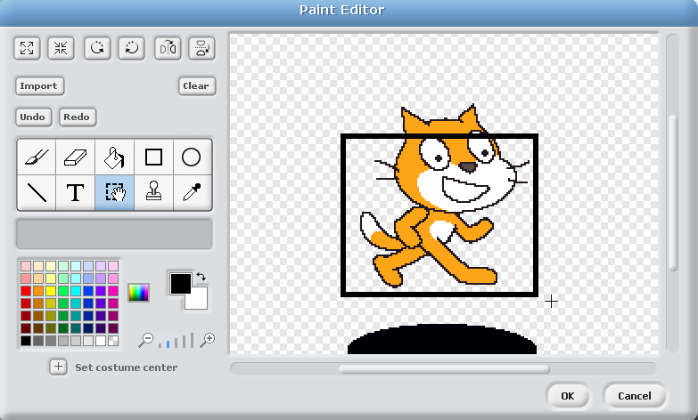
Select the 2nd cat and click edit.
This time start your selection a little lower - just below the ears.
Hit delete again so we just have his ears left.

Slide 13
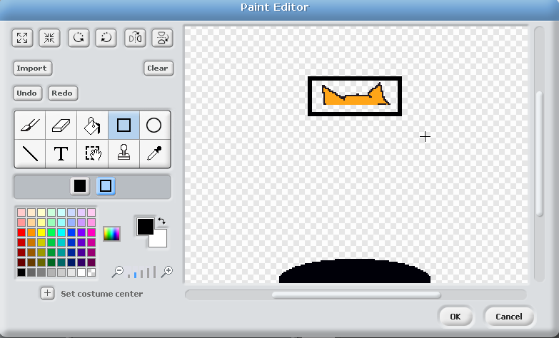
Now click the select tool again and drop a box round the ears.
Do not press delete this time - we want to keep the ears

Slide 14
When you put the mouse over the middle it turns into a little hand.
When it looks like that hold down the left mouse button -
now you can move the ears.

Slide 15
Drop the ears inside the black circle and click OK

Slide 16
Lets Save it again

Slide 17
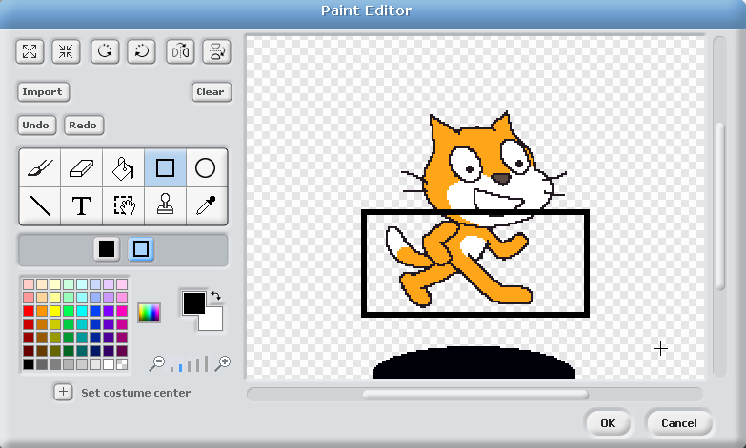
Edit the 3rd cat and start a bit lower. Delete the bottom part - myabe just above his neck. and then highlight the top part of the head and drag it downwards.

Slide 18
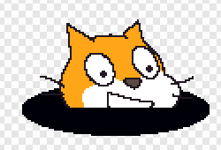
You should end up with something like this.
Click OK when you are done.
Click cancel if it goes wrong.

Slide 19
Edit cat 4 and repeat the process again. This time cut him in half somewhere round his waist. After you move it, he should look like this :

Slide 20
Edit cat 5 and make it look like this :

Slide 21
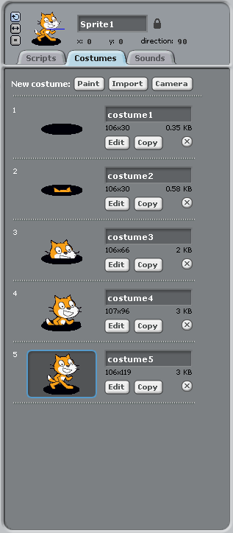
Your 5 costumes should now look like this :

Slide 22
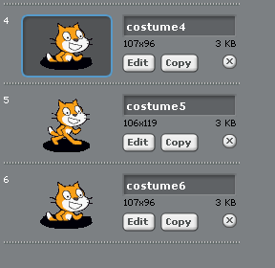
Click on ‘copy’ next to cat 4 and it will make a new one called number ‘6’
Next copy number 3 and then number 2.
You do not need to do number 1’
You should end up with 8 costumes.

Slide 23
Lets Save it again

Slide 24
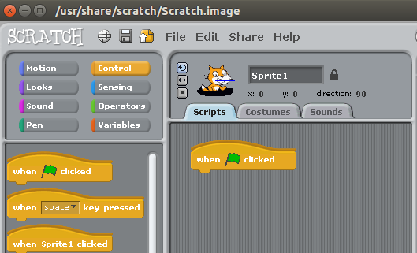
Lets start coding.
Click on scripts and then on the control button.
You now start picking up commands on the left and dropping them on the blank script area in the middle. Start with ‘When green flag is clicked’

Slide 25
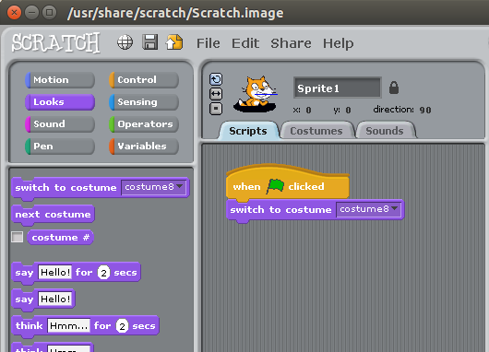
Next select the ‘looks’ button and add ‘switch to costume 8’ After you add it, click on the little arrow next to to costume 8 and pick costume 1 from the drop down list.

Slide 26
Next we are going to add a forever loop.
You will find this in the ‘control’ section.
A Loop means repeat the commands inside the gap over
and over and over and over again….

Slide 27
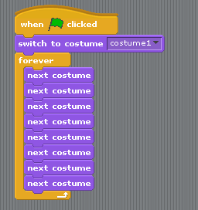
Now click on the ‘looks’ button and add in 8 ‘next costume’ command.
Drag them inside the forever loop.

Slide 28
Lets test. Click on the green arrow to start and the red blob to stop.
What does it do ?

Slide 29
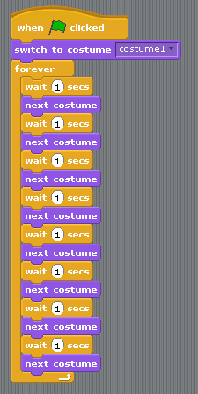
Back to control again. Drop in a ‘wait 1 sec’ commands in above each ‘next costume command’ You will need 8 of them.

Slide 30
Test again. Is it right this time ?

Slide 31
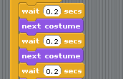
I think the cat is moving a bit slow.
Click on the ‘1’ and change it to ‘0.2’ work
down the list changing all of them.

Slide 32
Test again. Is it right this time ?

Slide 33
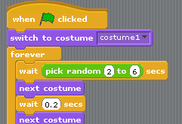
In Operators (the green button) pick up ‘pick random 1 to 10’ and drop it on the top wait so it goes over the number.
You only need this on the top one.

Slide 34
Lets add a new sprite - this time we will draw it.

Slide 35
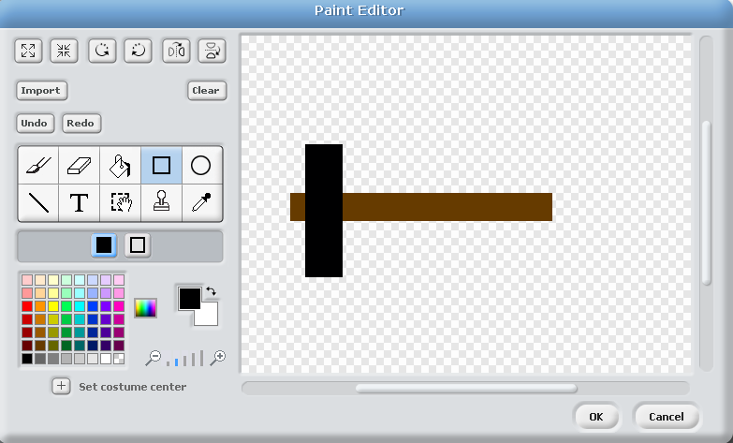
Pick the square tool and pick a colour. I’ve done the hammer handle brown and then done the other black :

Slide 36
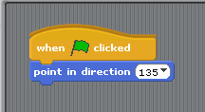
Now we need to add some code to make out hammer work :

Slide 37
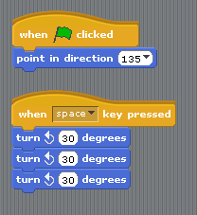
and another bit of code to make the hammer move when you press the SPACE bar

Slide 38
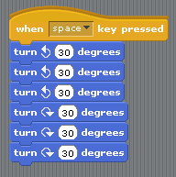
It goes down…. but we need it to go back up again. Lets add some moves in the other direction.

Slide 39
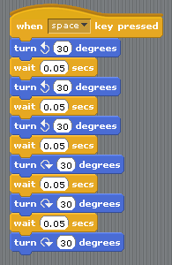
Test it. Hmmmm - now it is so fast you cannot even see it. lets slow it down a bit. make sure the number for each ‘wait’ command say 0 . 05

Slide 40
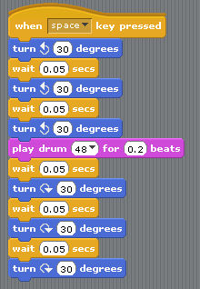
and to finish it off lets add a noise. You will find the noises under the ‘sound’ section on the left. It goes in right under the third ‘turn’ command.

Slide 41
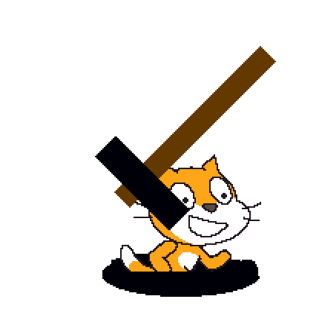
Test it again. Maybe we need something to happen when the hammer hits the cat ?

Slide 42
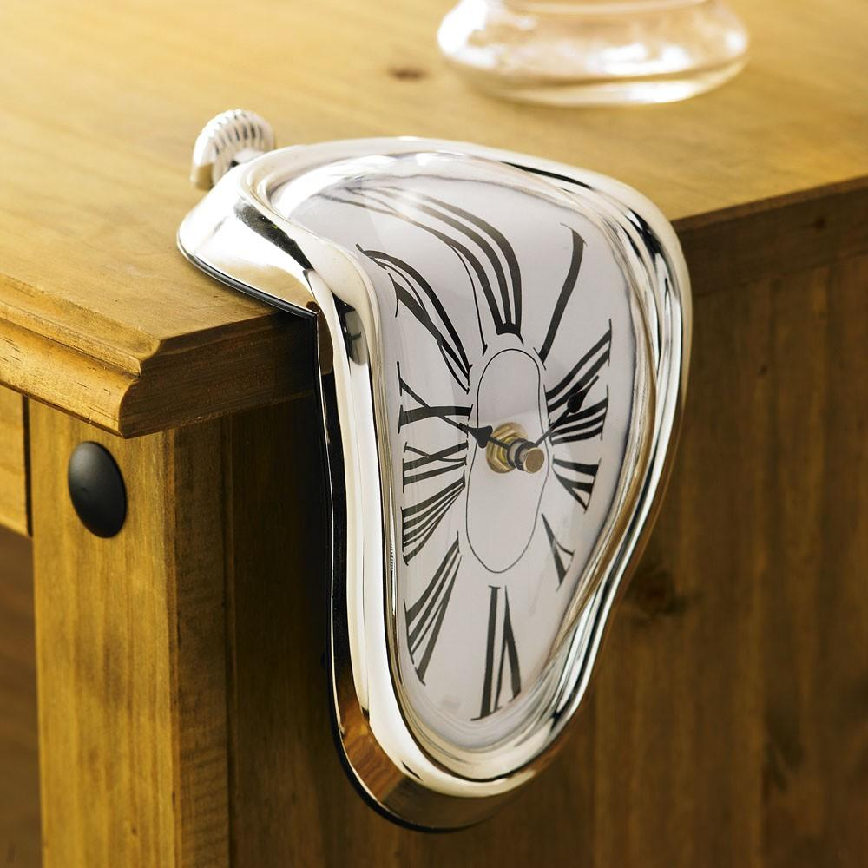
Break time… take 5 minutes. Rest your eyes, legs, fingers and all that.
Have a drink and a snack - keep up the energy levels - we have a LOT more work to do...

Slide 43
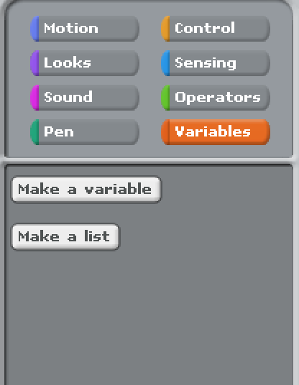
We need to add some Variables. You find these by clicking on the ‘Variables’ button and then ‘make a variable’

Slide 44
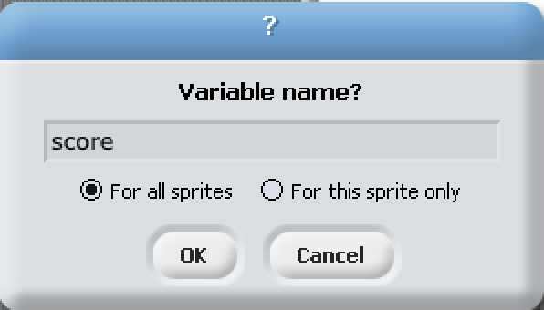
Lets add one called ‘score’ (with the dot in ‘for all sprites’)

Slide 45
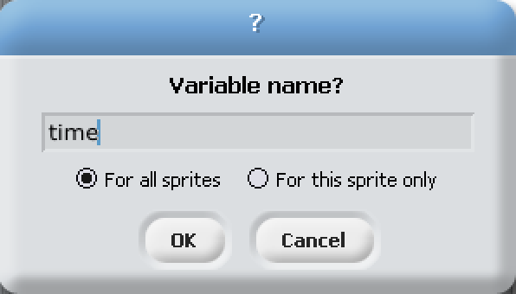
..and another called ‘time’ (again with the dot in ‘for all sprites’)

Slide 46
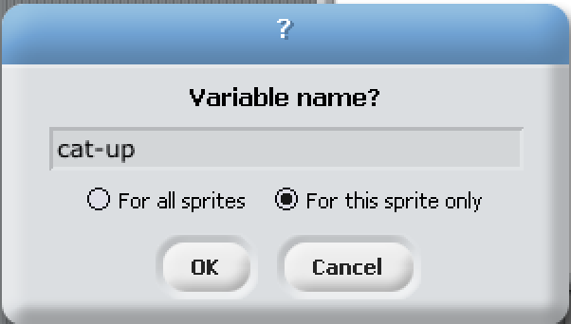
Make sure the cat is selected in the bottom right corner and then add another variable called cat-up.
This time change the dot to ‘for this sprite only’

Slide 47
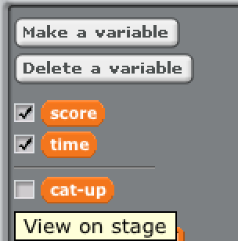
Untick the cat-up variable so it does not show up on the screen.
(click it on and off a few times so you can see what this does)

Slide 48
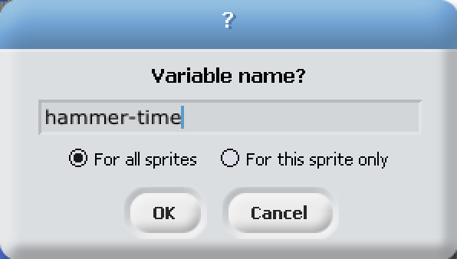
Last one… Click on the hammer and then make a variable again.
Call this one ‘hammer-time’ and leave the dot on ‘for all sprites’
Untick this one so it does not show up on the screen.

Slide 49
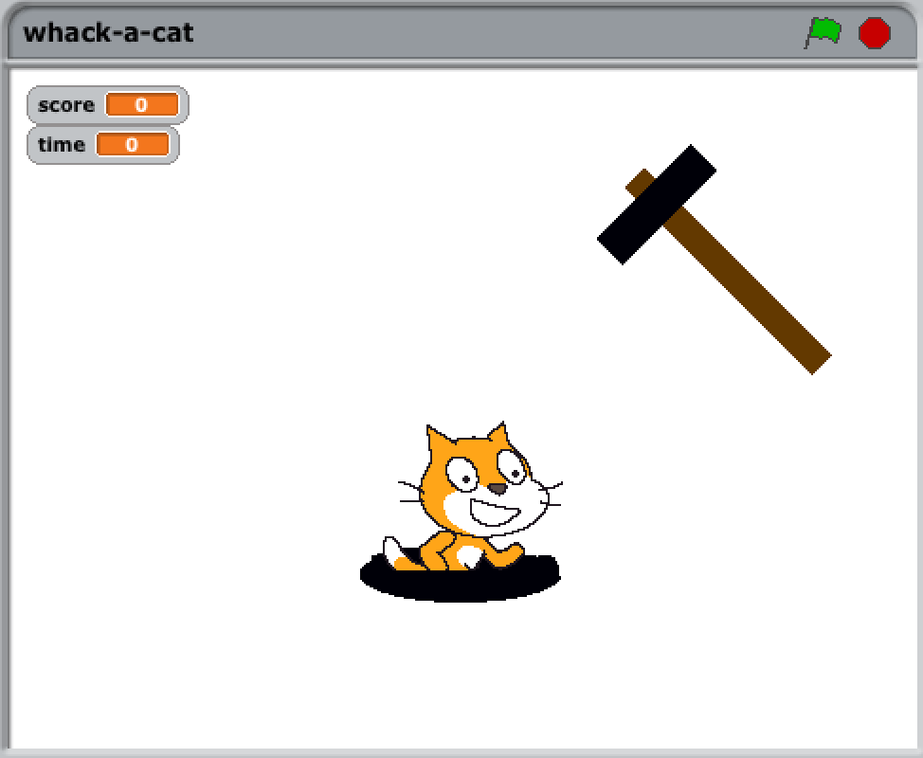
You should currently have something like this :

Slide 50
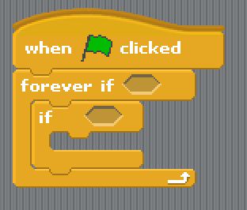
Now lets build up the main game ‘loop’. This will control what happens in the game.
Click on Sprite 1 - The cat.
Start by building this (all from the control area) :

Slide 51
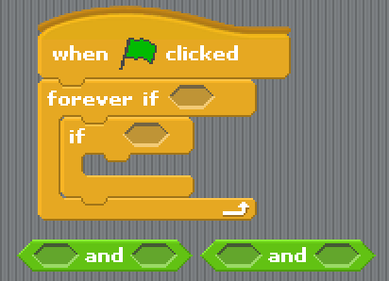
Go to the ‘operators’ area and get an ‘and’ command. Now get another one - we will need two of them for this.
‘and’ does exactly what it sounds like. Do something if this AND that happen.

Slide 52
Now go to ‘sensing’ and find ‘touching’ command at the top of the list. Drag it out and then click the drop down arrow and pick ‘sprite 2’ (which should be the hammer) When you have it set drop it in the first ‘and’ box

Slide 53
We need another couple of bits to make this all work. Go to ‘operators’ and drag out two of the ‘=’ signs. This is a bit complex - it will make sense in a few minutes (honest)

Slide 54
Click on the Variables button on the left and make sure the cat is selected on the right. Now pick up the names of the new variables you made ‘cat-up’ and ‘hammer-time’ and drop them in these boxes :

Slide 55
click on each white box and add the word ‘yes’

Slide 56
Pick up both of them (put the mouse on the ‘=’ sign and grab there. It makes it easier). Drop them into the two holes on the second green thing. Wait until you see a glowing white things in the right place and then drop.

Slide 57
Now drop this into the hole in the first one. Pick up by clicking on the ‘and’ and the left hand side is the bit that will get the white glow so aim the very left hand side into the box and then drop.

Slide 58
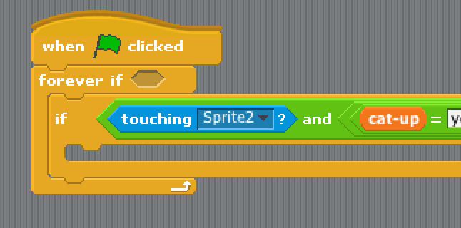
And we drop all of that ‘thing’ we just made into the ‘if’ loop
What does it mean ? If we are touching the hammer
and
cat is up
and
It is hammer time (the hammer is swinging) ...then....... what would happen ?

Slide 59
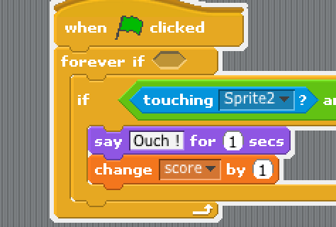
What happens ? The cat says ‘Ouch !’
and the score goes up by 1 (‘say’ is in looks and ‘change’ is in variables or data)

Slide 60
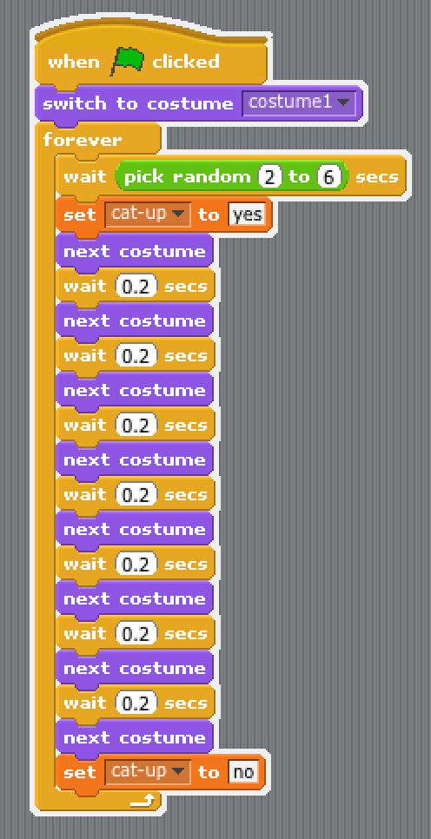
In Sprite1 (the cat) we need to add some code to the big loop so we know when the cat is up or down
You’ll find them in ‘variables’ (or data).
Drag them to just under the ‘wait line’ and to the bottom of the loop and set the name to ‘cat-up’ and the values to ‘yes’ and ‘no’

Slide 61
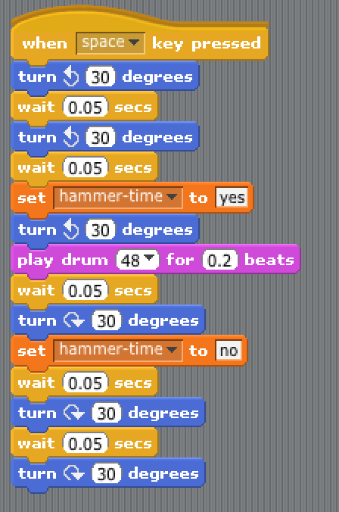
and in the hammer sprite code area we do the same for ‘hammer time’
get them in the right places :

Slide 62
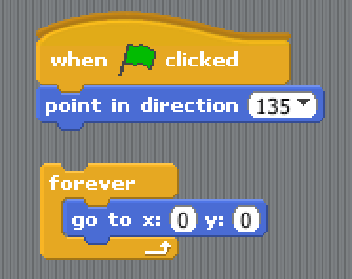
Still under the hammer sprite - lets make it move. You already have a small bit of code - add this to the bottom of it : (the goto x:y: bit is in ‘motion’)

Slide 63
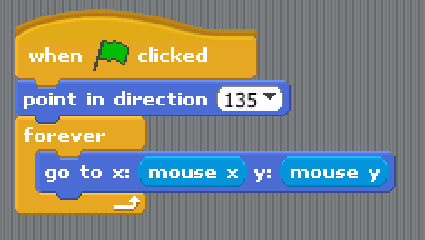
get ‘mouse x’ and ‘mouse y’ from ‘sensing’ and put them into the holes.
and then stick it all together :

Slide 64
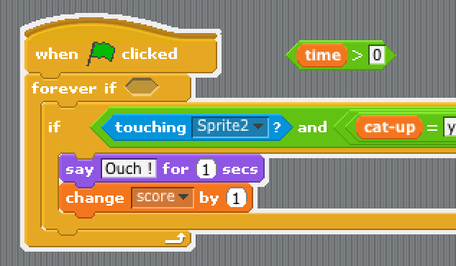
Last step (honest) We just have to get the time bit working…
On the cat (sprite 1) get a ‘greater than’ (>) sign in the operations area and add ‘time’ into it from variables. Make the other box say zero and put it in place in the forever loop

Slide 65
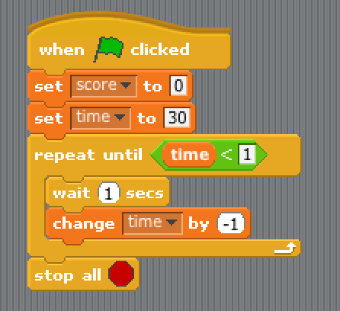
Click on the stage icon (the white box).
Add in this code to make the time count down

Slide 66
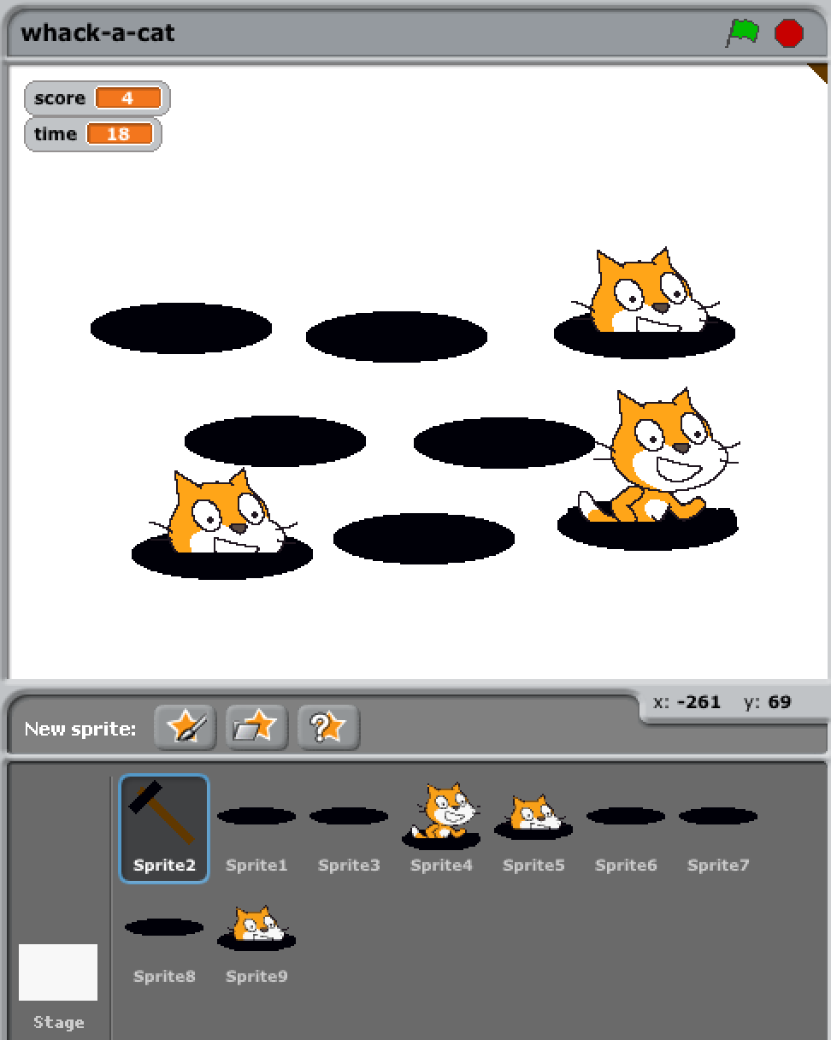
Right click on the cat sprite (on a mac press CTRL and click)
and select duplicate sprite. Make 7 or 8 of them and move them on the screen :

Slide 67
What have we used today ?
Loops
Variables
‘If’

Slide 68
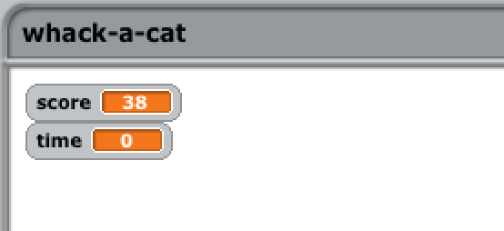
Thats it - you have just coded your first game.
Does that make you a CoderDojo Ninja ?

Slide 69
No.

Slide 70
A CoderDojo Ninja is someone who takes it further and
makes it into their own unique game.
Some ideas :
* Different graphics for the cat ?
* Sound FX - make better NOISE !!!
* How about a background ?
* Better hammer ?
* What about moving the holes ?
* and most important… add your own ideas...

Slide 71
Did you miss any steps ? This presentation is available on our website : www.donabateDojo.com
Click on ‘lessons’

Slide 72
Please note - The design and idea for this game are borrowed from Al Sweigart http://scratch.mit.edu/projects/11629018/ (big thank you)
Also a big thank you to
The Donabate Dojo Mentor team.
The Community Centre for the room and setting it up.
The mums and dads and adults for transport and help
and most of all - Thank you to our new Ninjas (thats you)
Comments, suggestions, donations, questions to :
email : team@donabateDojo.com
Facebook : www.facebook.com/DonabateDojo
Twitter :@DonabateDojo
Website : www.donabateDojo.com

