Slide 2
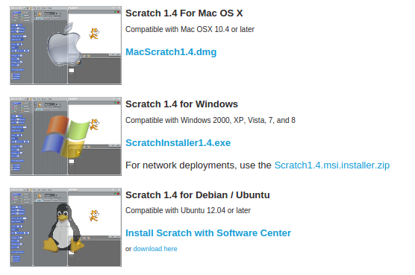
Install Scratch
Go to => http://scratch.mit.edu/scratch_1.4/

Slide 3
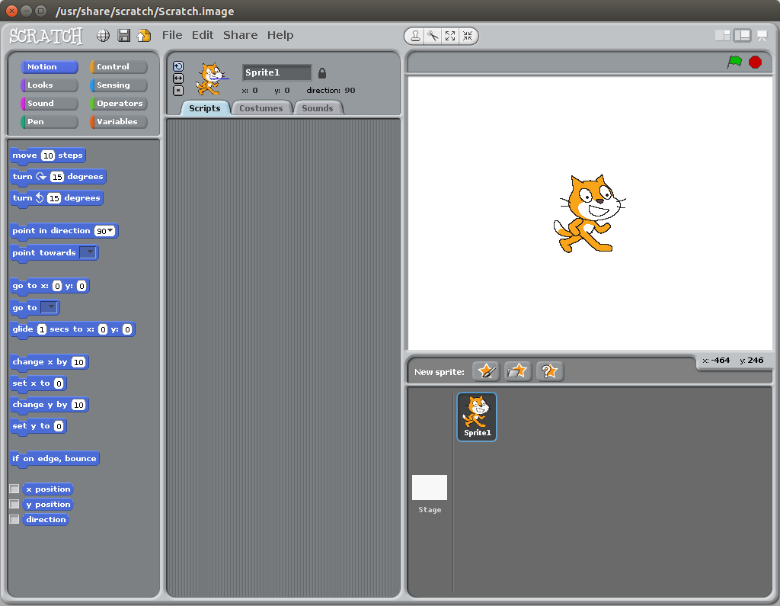

Slide 4
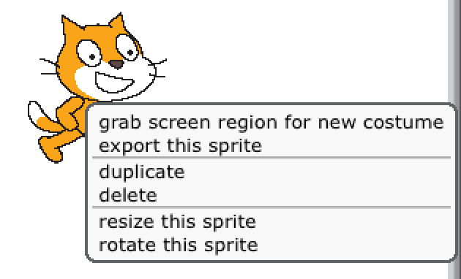
Lets get started. We do not need the cat in this game so right click on the cat (on a mac you hold ctrl and click it) and then select ‘delete’

Slide 5
Now lets add something else. Click on the ‘choose a new sprite from file icon down in the bottom right.

Slide 6
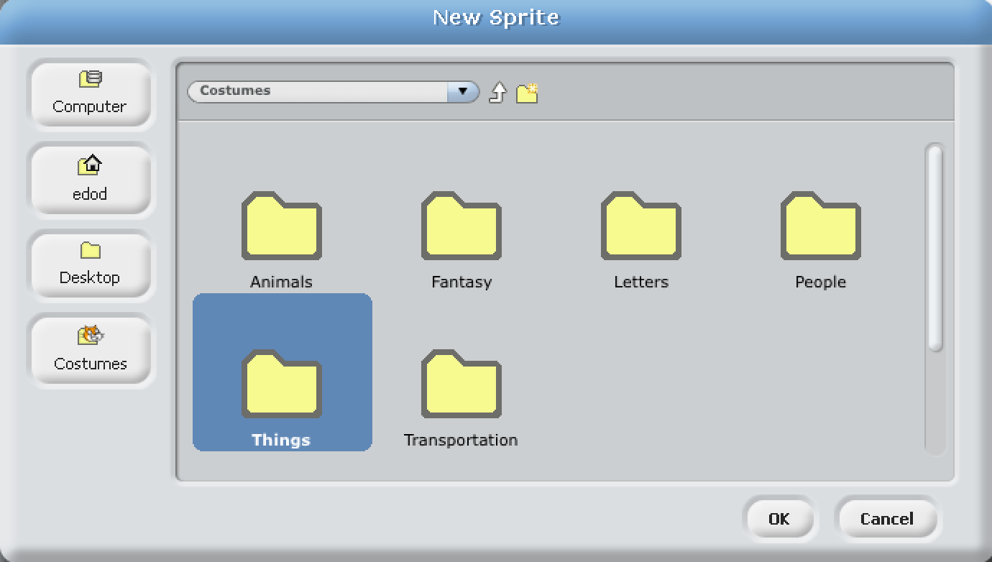
Go into the ‘things’ folder

Slide 7
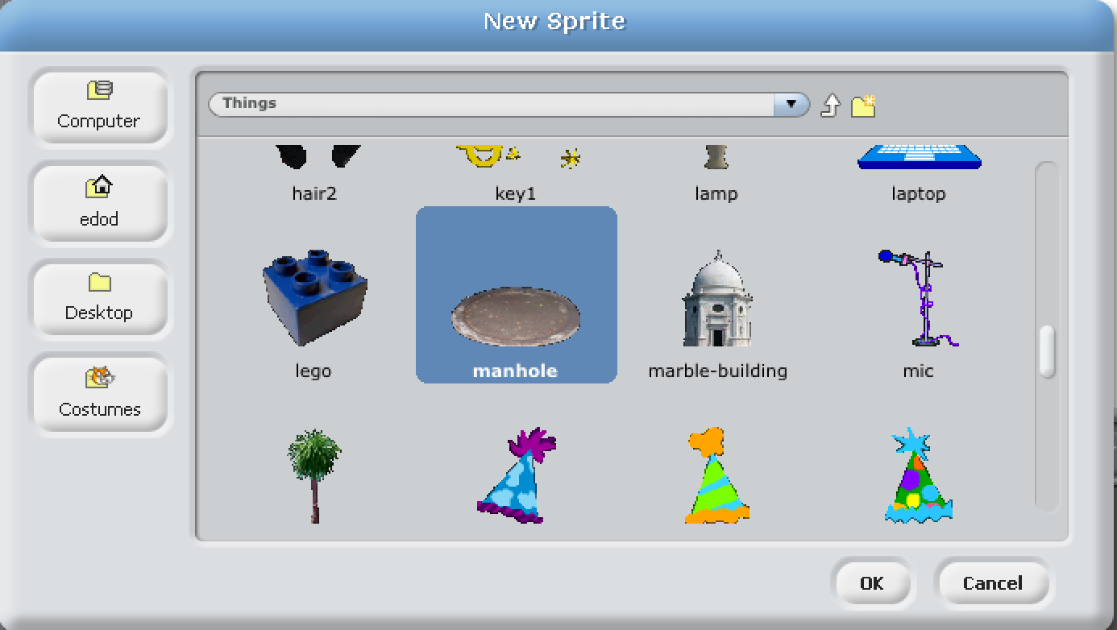
...and select the manhole

Slide 8
It is a good idea to save your game now and then so you can always go back if it gets messed up or even goes wrong and crashes.
Click ‘save’ icon and type in a name.
Lets call this one guess

Slide 9
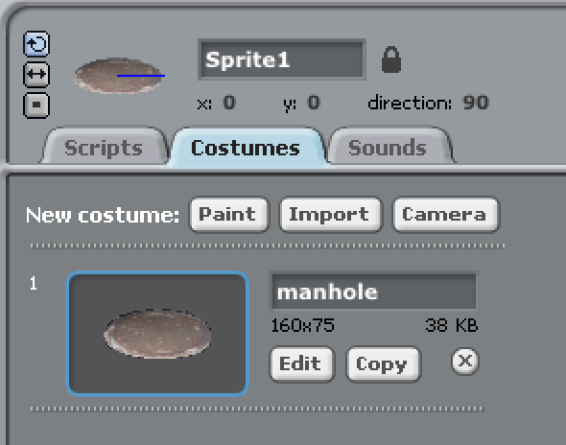
Click on costumes - this allows us to change what the sprite looks like.
Click on ‘copy’ so you get another image. (On other version of scratch it is called duplicate or looks like a stamp)

Slide 10
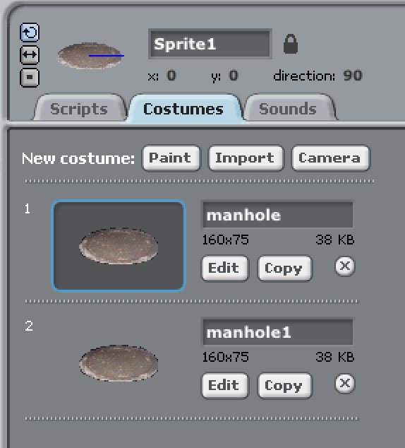
Click on Edit on the bottom picture

Slide 11
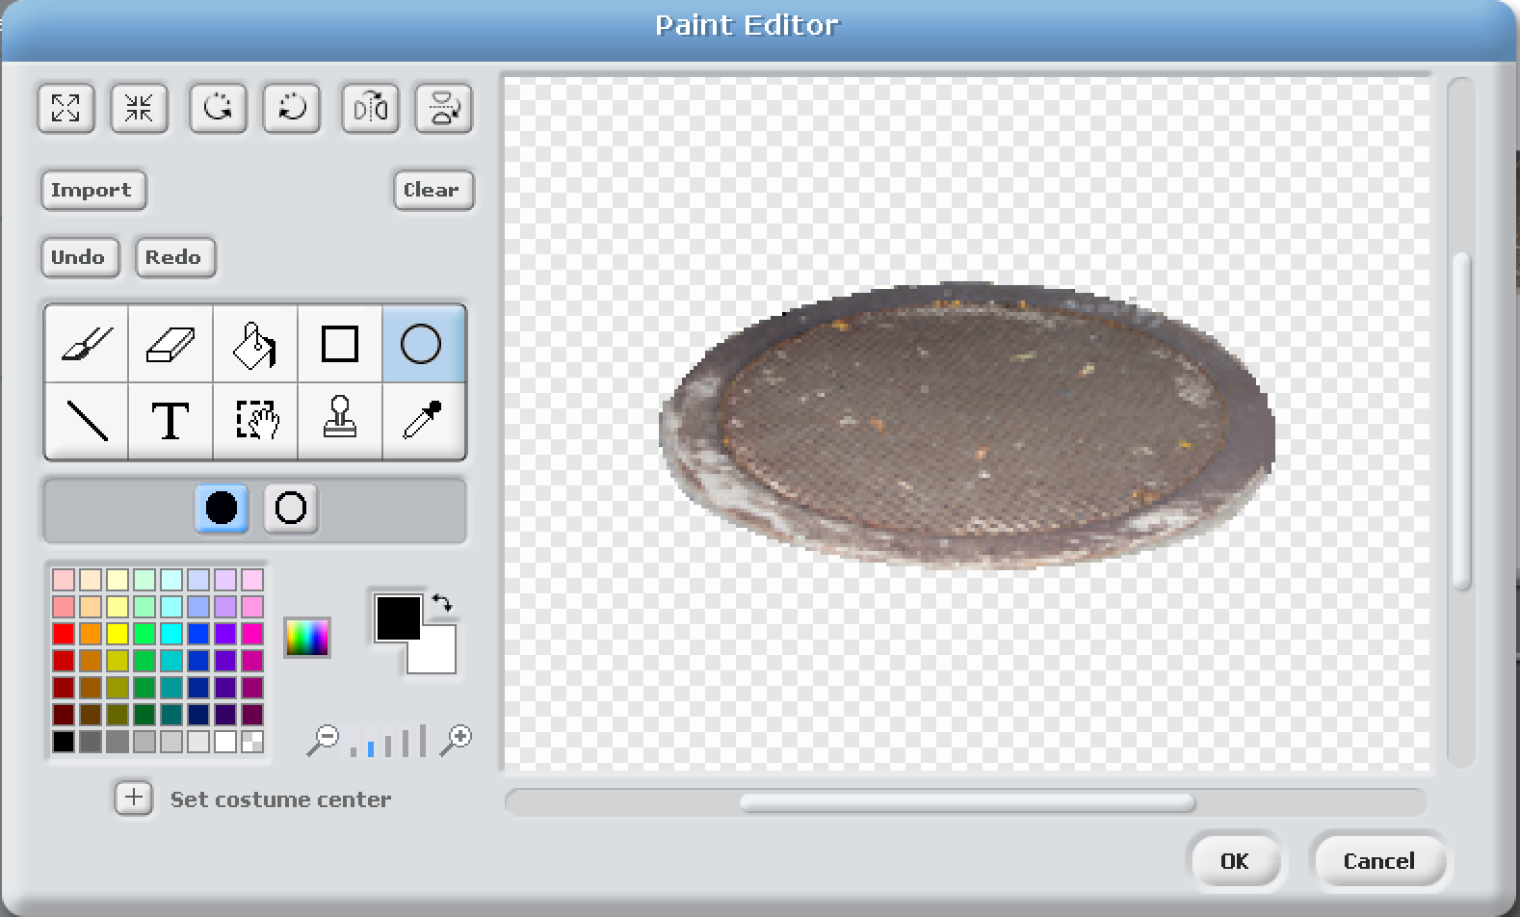
Select the circle tool and make sure it is the filled in version. Now click roughly where the ‘x’ is on the picture. This is inline with the top and the left hand side and then drag to the other ‘x’. It should turn the manhole into a black hole. If it goes wrong hit ‘undo’ or ‘cancel’

Slide 12
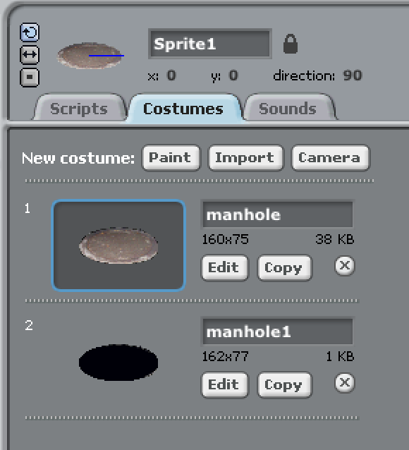
When you are finished click ‘OK’. It should look like this. Make sure the manhole with the cover is selected.

Slide 13
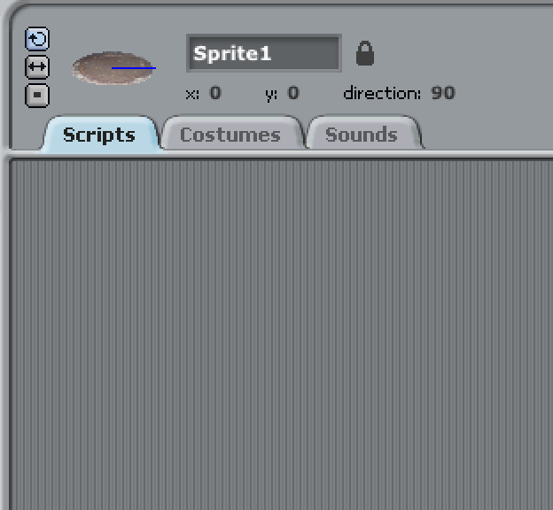
Now click on Scripts so we can change the code for this manhole.

Slide 14
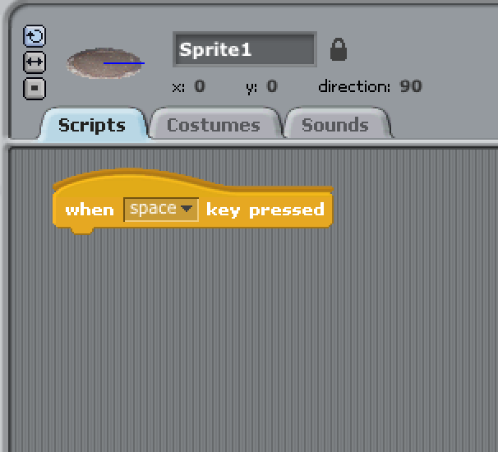
Click on the ‘Controls’ button and drag this command onto the
area in the middle.

Slide 15
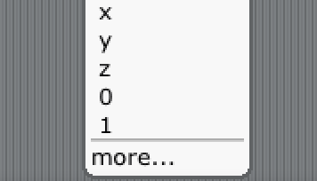
Click on the little arrow next to ‘space’ and from the drop down
menu pick ‘1’. If you do not see it, click ‘more...’ and you
should find it in there.

Slide 16
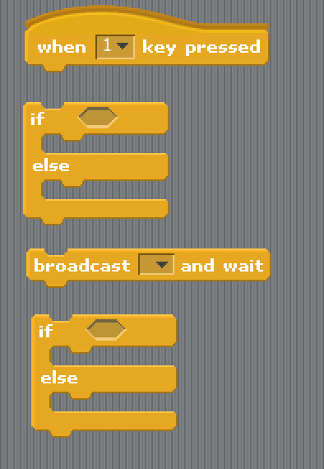
Now we need some more items from the ‘controls’ area. Find these and drag them on :

Slide 17
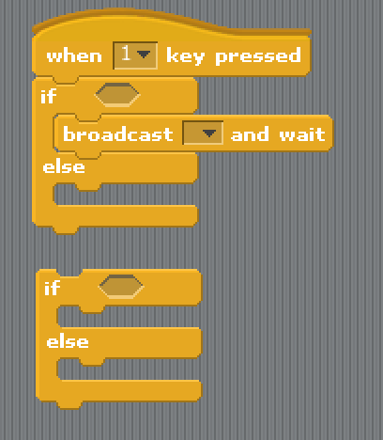
Join the top ‘if’ statement onto the top. Put the ‘broadcast’ command inside the top hole.

Slide 18
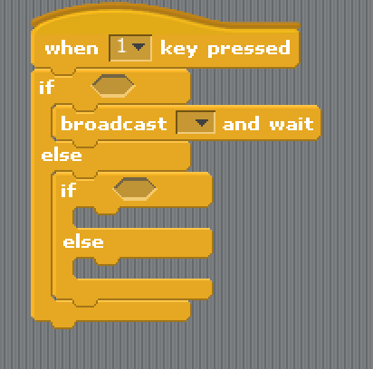
and put the other ‘if’ statement inside the bottom hole.

Slide 19
Remember to save...

Slide 20
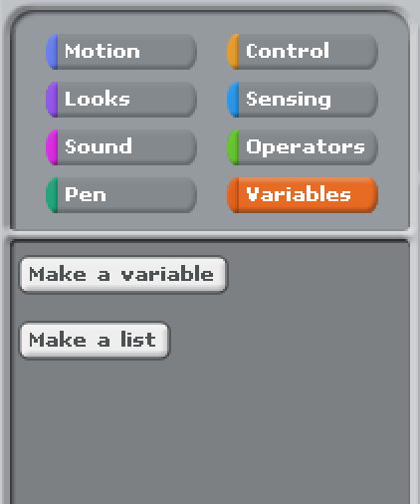
Now we need a variable.
A variable is like a storage box. You name it and then
put something into it like a number. Click on ‘make a variable’

Slide 21
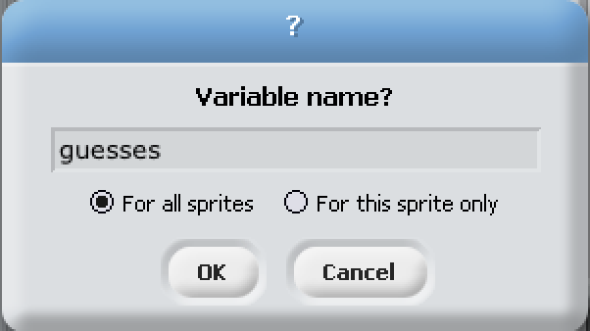
name it ‘guesses’ leave the ‘dot’ on ‘for all sprites’ and click OK

Slide 22
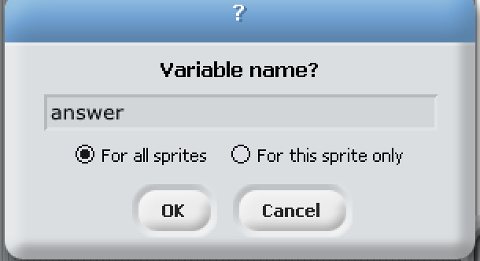
Now create another one called ‘answer’

Slide 23
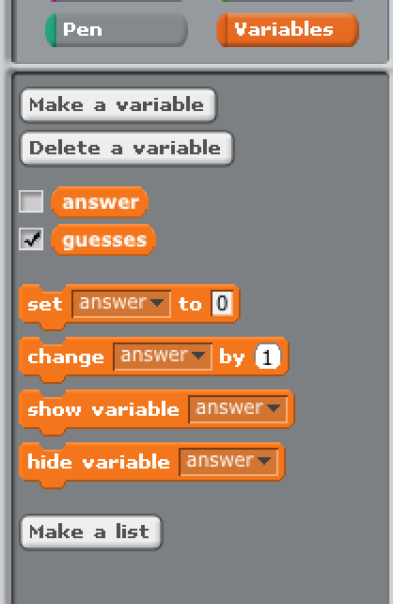
Remove the tick next to ‘answer’. This removes it from the screen (well that would make guessing it a bit easy if you could see it)

Slide 24
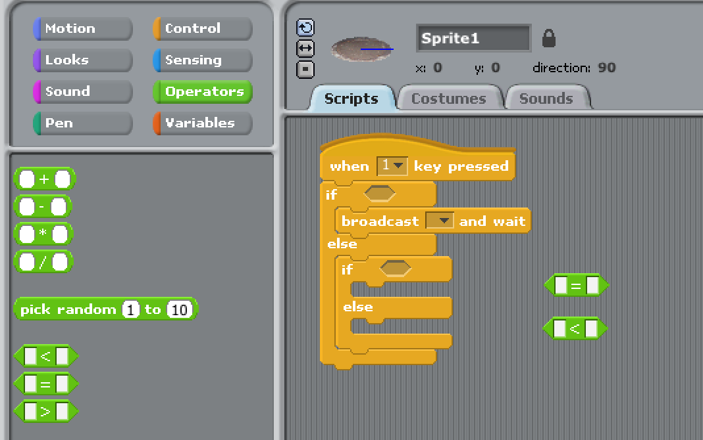
Now to make the ‘if’ statements we need to compare things. Click on ‘operators’ and drag on an ‘=’ and a ‘<’ The ‘=’ means the two things are equal The ‘<’ means the one on the left is less than the one on the right. We are not using it but ‘>’ means greater than.

Slide 25
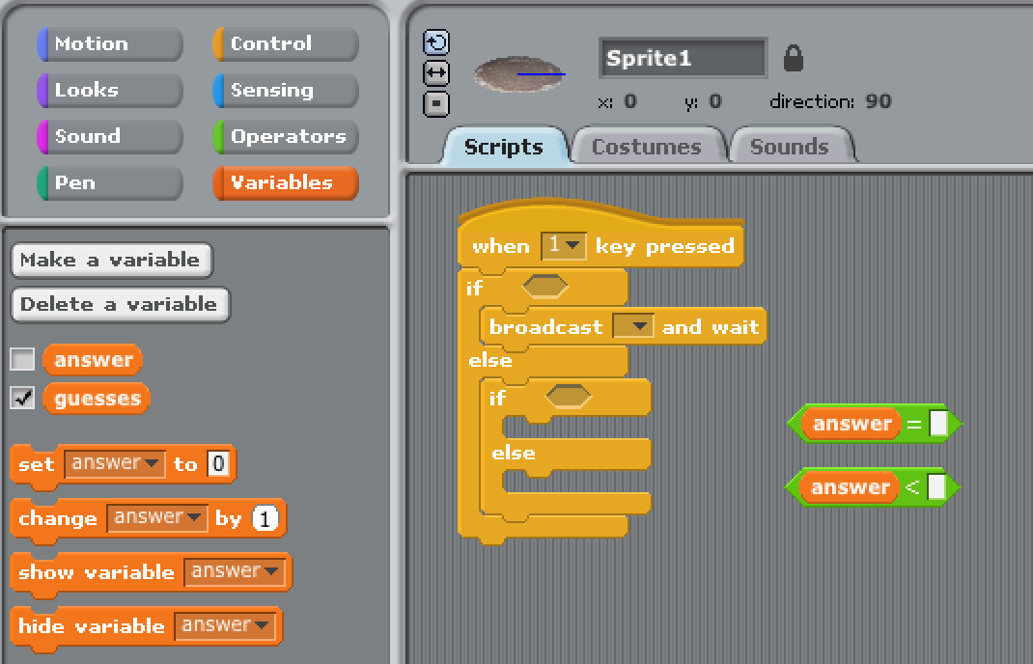
Now go back to ‘variables’ and pick up ‘answer’. Drop it in the left hand box. Repeat this again and drop it in the other left hand box.

Slide 26
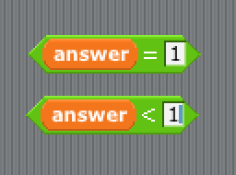
and click on both right hand boxes and type in the number ‘1’ into both.

Slide 27
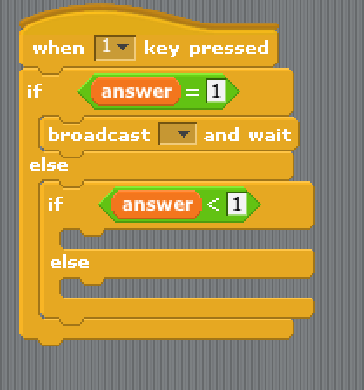
Pick them up and put them in the two holes by ‘if’. It works best if you pick it up by the ‘=’ and ‘<’ signs and drop it when you see the white square round the hole you are trying to drop it into. (It works best for the left hand side of the thing you are dropping)

Slide 28
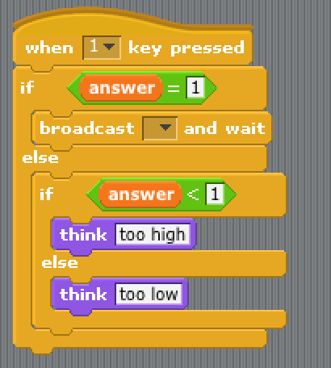
Under ‘looks’ you’ll find ‘Think Hmm...’.
Drag two of these out and change the text to ‘Too high’ and ‘Too low’

Slide 29
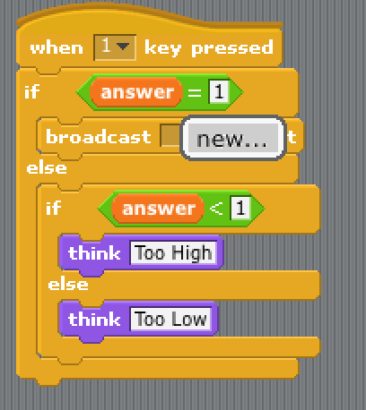
Now click on the little drop down arrow next to broadcast and select ‘new’

Slide 30
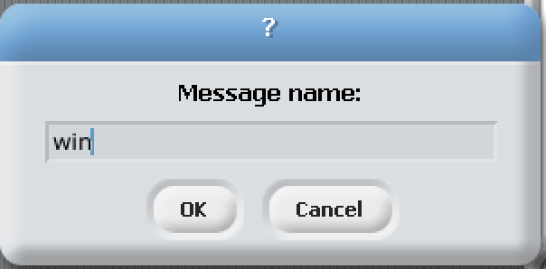
Name it ‘win’. This means if you win - it tells all the other sprites.

Slide 31
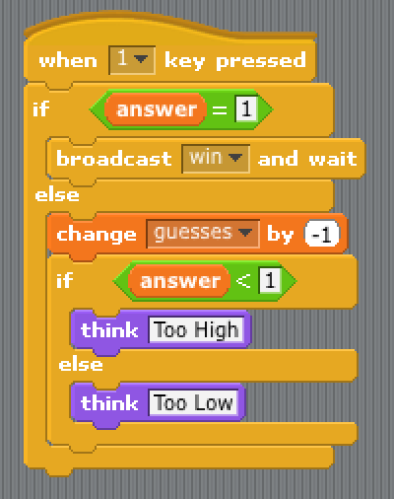
After each guess we need to lower that number. Go to variables and drag on ‘change [...] by [...]’
put it here and set the boxes to ‘guesses’ and ‘-1’

Slide 32
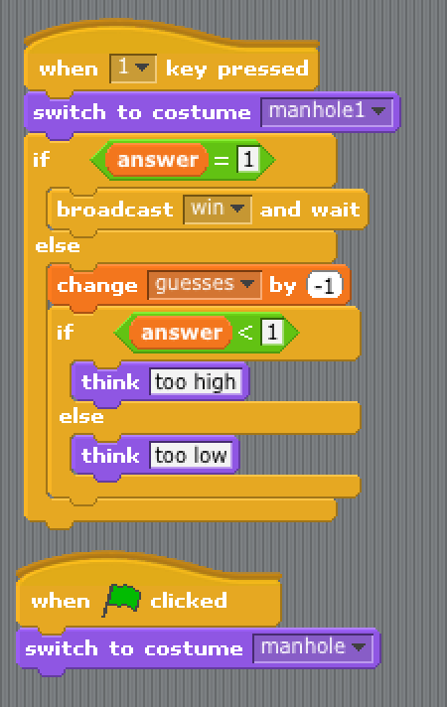
Now we change the manhole to an open manhole when it has been picked, and back to a closed one when we start the game.
The top one says ‘manhole1’ the bottom one says ‘manhole’

Slide 33
Remember to save...

Slide 34
Lets make the manhole a little smaller.
Click on the arrows that point into the centre and then click on the manhole about 15 times.

Slide 35
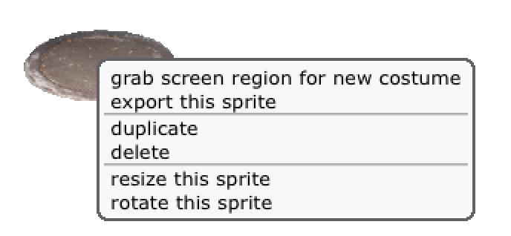
We need more manholes. Right click on the icon in the
sprites area and click ‘duplicate’. On other versions of sprite select the ‘stamp’ icon
and then click on the manhole. Keep going until there are 9 of them.

Slide 36
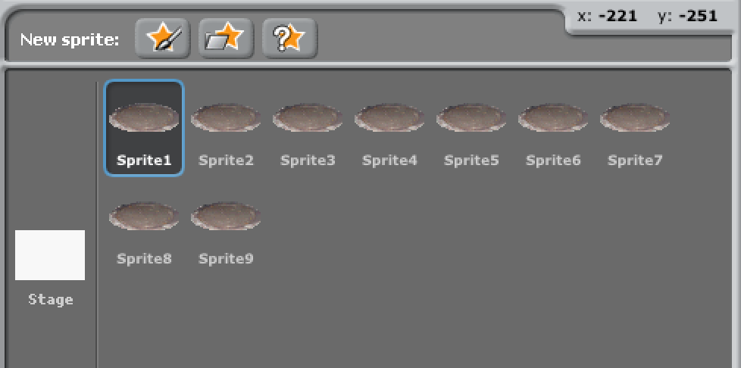
It should now look a bit like this :

Slide 37
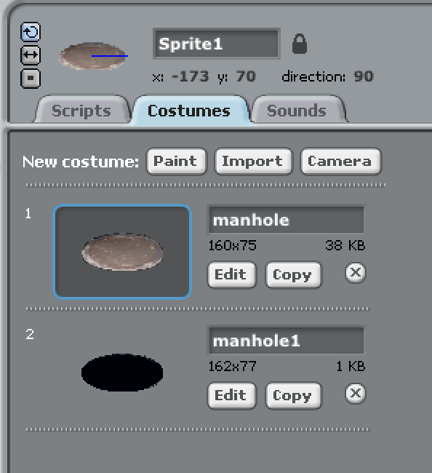
Click on sprite 1 and then on costumes.
Click on ‘edit’ on the one with the closed manhole.

Slide 38
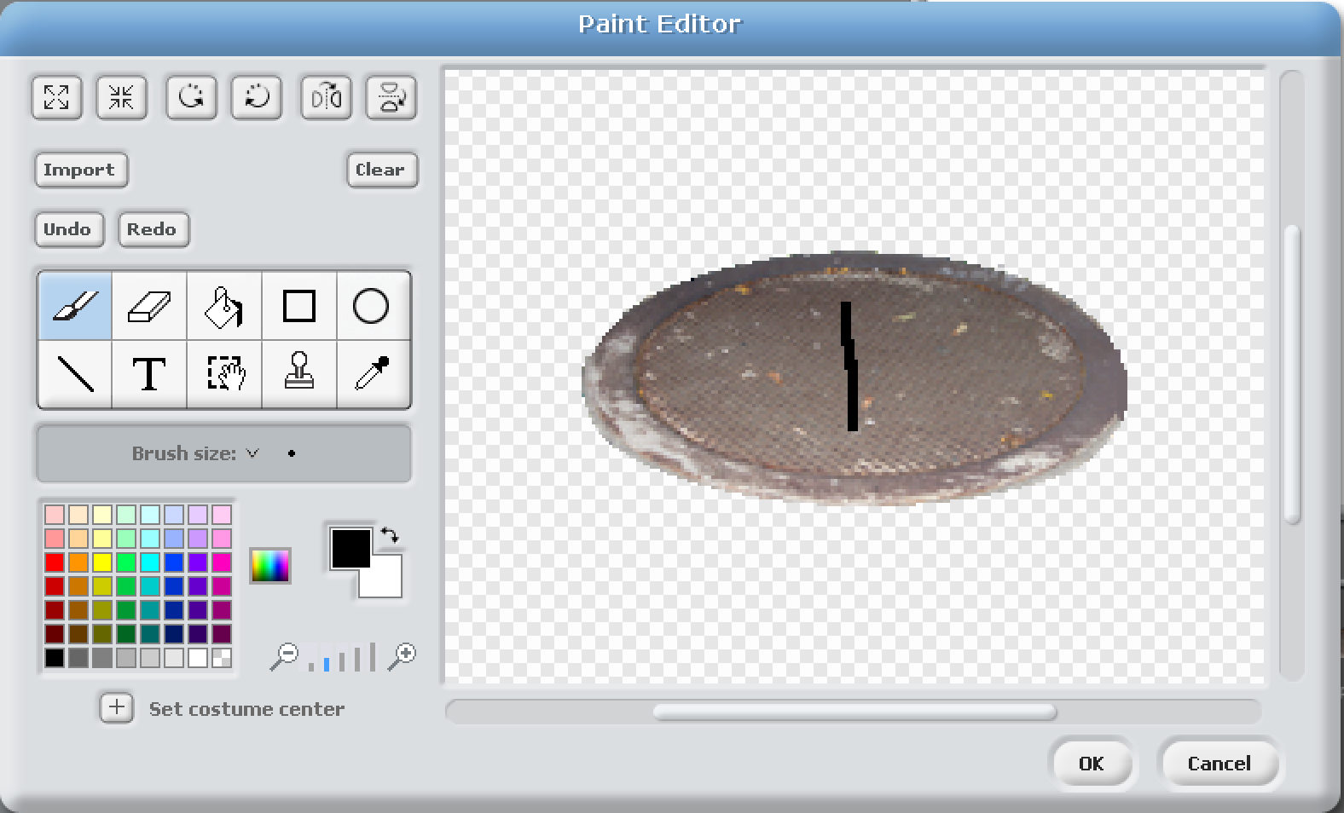
Draw on a number ‘1’ and click ‘ok’ If it goes wrong click undo.

Slide 39
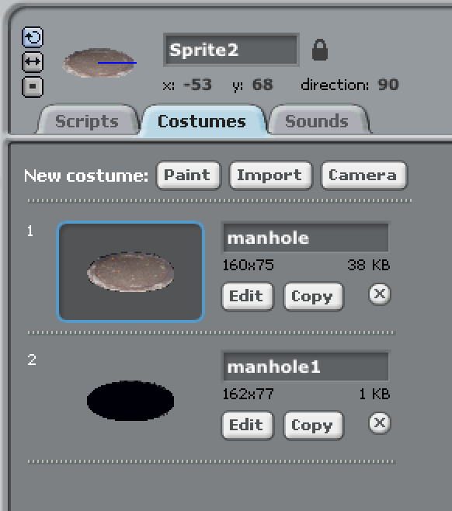
Do the same for sprite 2, edit the manhole.

Slide 40
...and you guessed it - add a number 2.

Slide 41
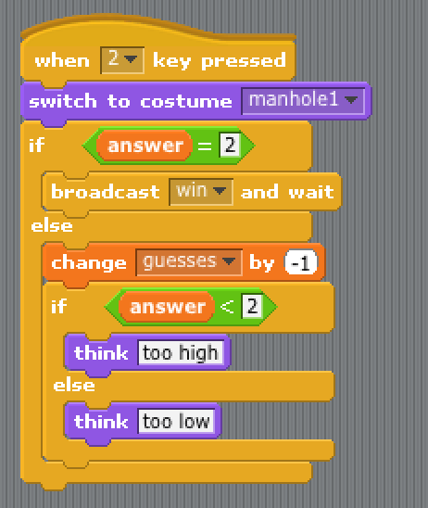
Still on sprite 2 : Click on scripts, select the number ‘2’ at the top (remember to use ‘more...’ if you do not see numner ‘2’) and then edit the other boxes to say ‘2’

Slide 42
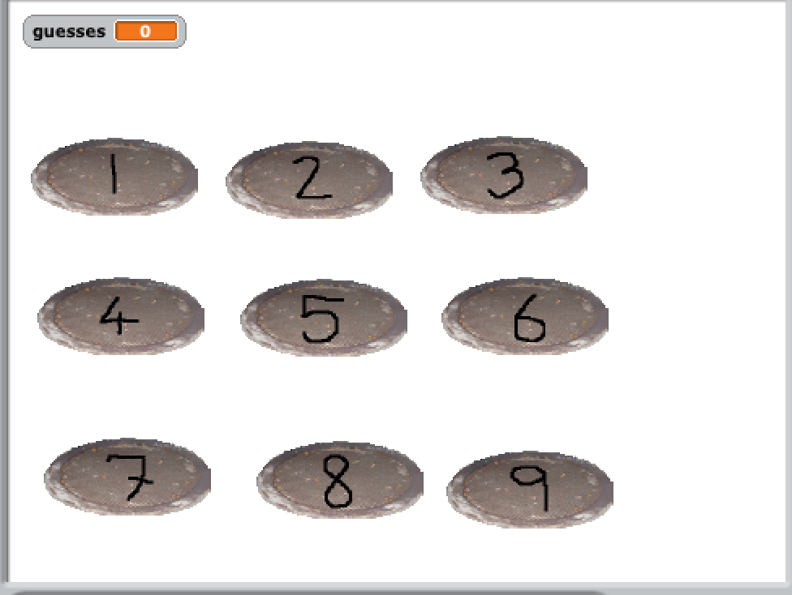
Repeat until you get all of them done. Remember each one needs the picture edited and also its number put in the scripts bit 3 times.
When you are all done line them up like this :

Slide 43
Remember to save...

Slide 44
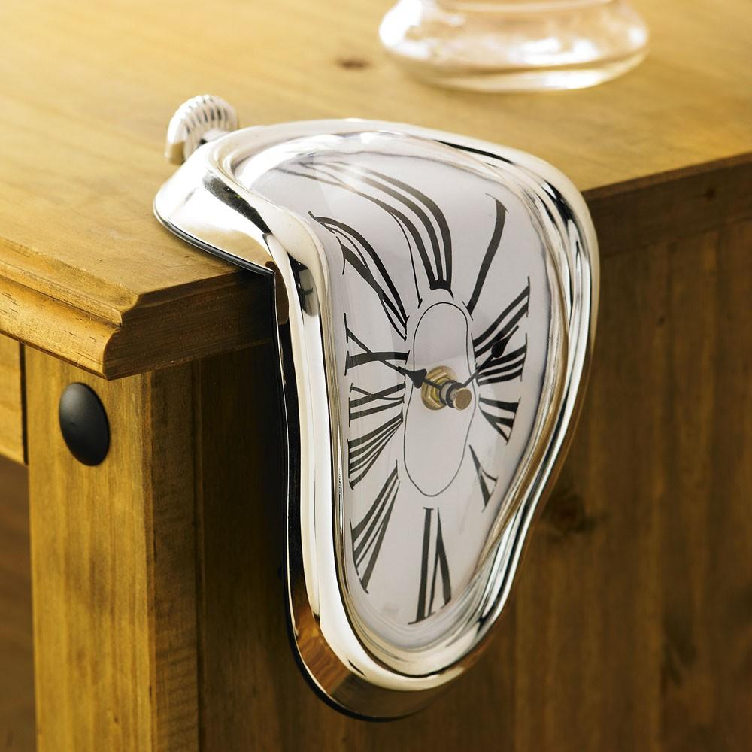
Break time… take 5 minutes. Rest your eyes, legs, fingers and all that.
Have a drink and a snack - keep up the energy levels - we have a LOT more work to do...

Slide 45
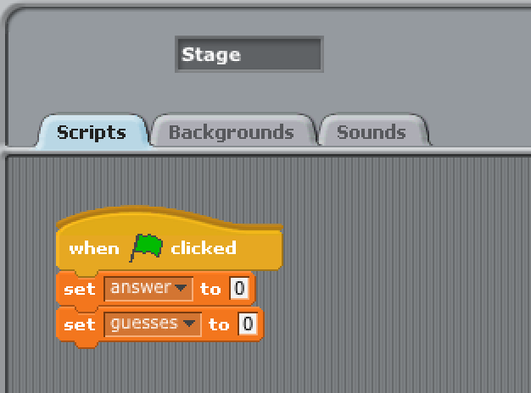
Click on ‘stage’ in the icons area (the white square). Click on scripts and add these items. The top one is in controls and the other two are in ‘variables’

Slide 46
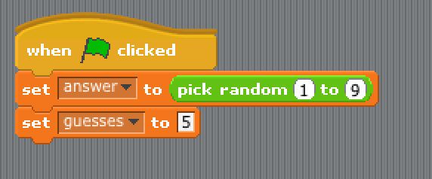
The top one ‘answers’ gets set to ‘pick random 1 to 9’ (which you will find in operations - but you may have to change the numbers).
The bottom one ‘guesses’ should be set to ‘5’

Slide 47
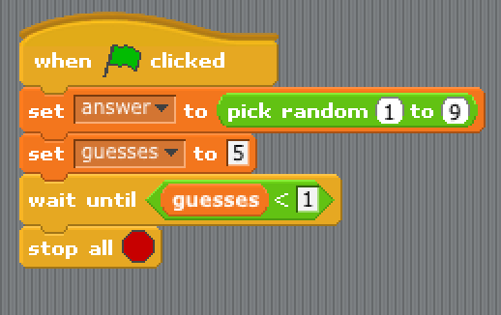
Two more lines on the bottom - You’ll find the bits in ‘control’, ‘Operators’ and ‘variables’

Slide 48
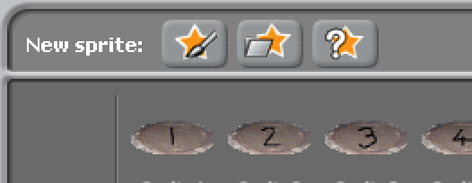
We are almost there….. Now we need a sprite to show we have won.
Click on the new sprite icon again (the one with the grey folder)

Slide 49
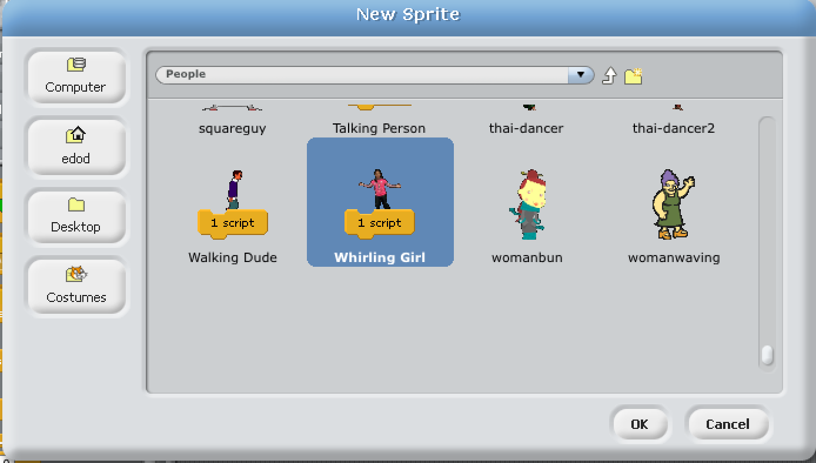
Select the ‘people’ folder. (If you do not see it use the white ‘up’ arrow) and then go down to the bottom and find the ‘Whirling girl’

Slide 50
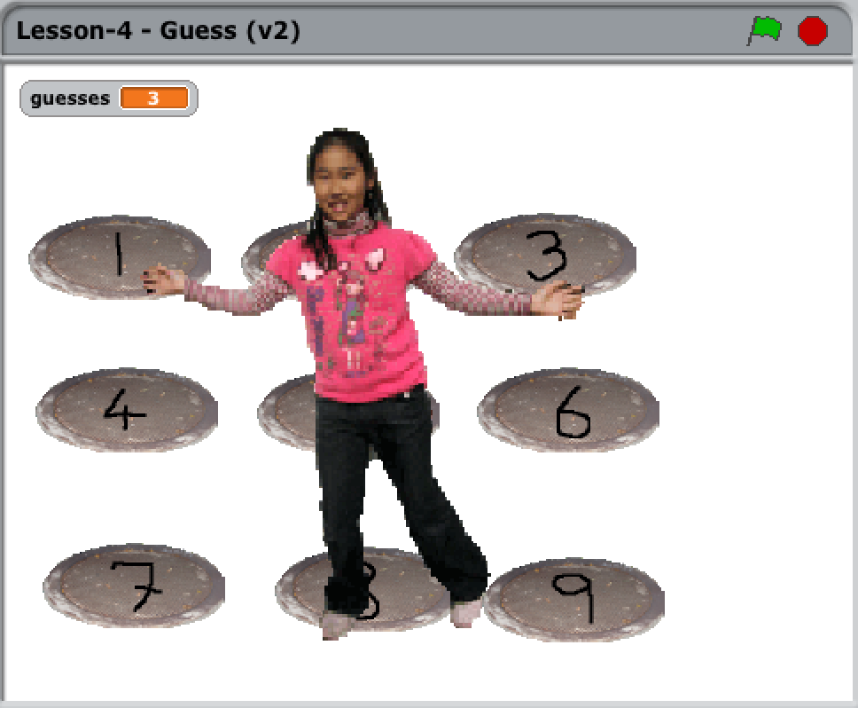
Place her in the middle and make her bigger
(use the 4 arrows that point out from the centre)
I clicked about 15 times.

Slide 51
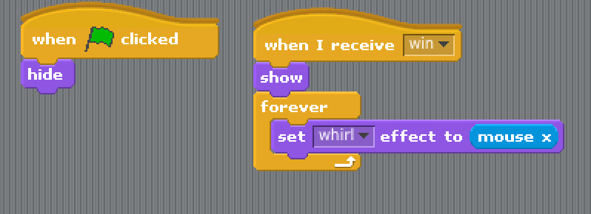
Change the scripts for the girl to look like this.
Anything that is missing is probably on the ‘looks’ button area

Slide 52
What have we used today ?
Loops
Variables
‘If’

Slide 53
Thats it - you have just coded your first game.
Does that make you a CoderDojo Ninja ?

Slide 54
No.

Slide 55
A CoderDojo Ninja is someone who takes it further and
makes it into their own unique game.
Some ideas :
* What about different graphics when you win ? * Sound FX - make some NOISE !!!
* Fireworks ?
* Something hidding in the manholes ? Maybe a baddie.
* What about a time limit ?
* and most important… add your own ideas...

Slide 56
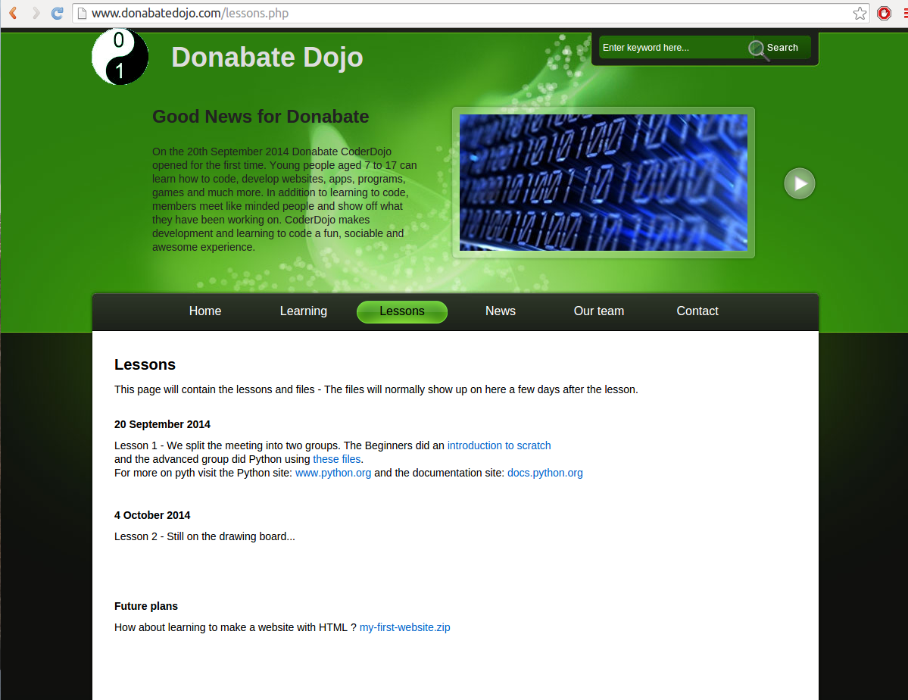
Did you miss any steps ? This presentation is available on our website : www.donabateDojo.com
Click on ‘lessons’

Slide 57
A big thank you to
The Donabate Dojo Mentor team.
The Community Centre for the room and setting it up.
The mums and dads and adults for transport and help
and most of all - Thank you to our new Ninjas (thats you)
Comments, suggestions, donations, questions to :
email : team@donabateDojo.com
Facebook : www.facebook.com/DonabateDojo
Twitter :@DonabateDojo
Website : www.donabateDojo.com

