Slide 2
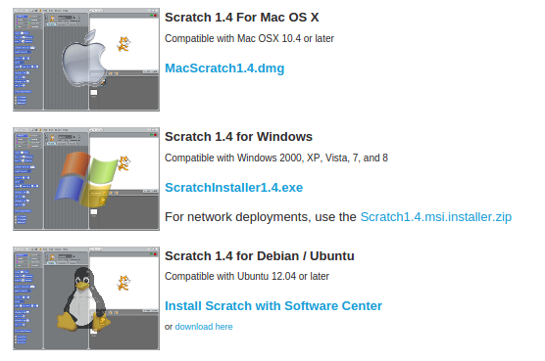
Install Scratch
Go to => http://scratch.mit.edu/scratch_1.4/

Slide 3
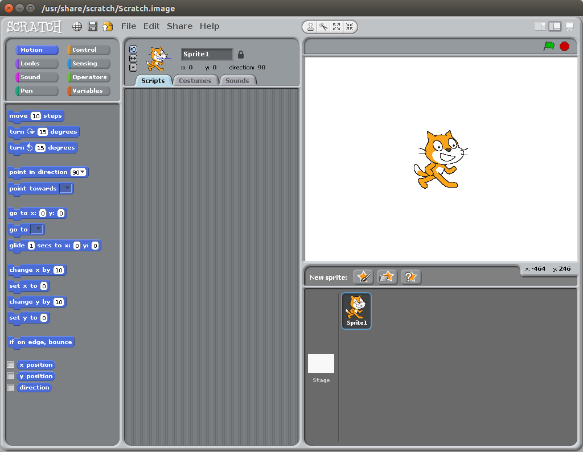

Slide 4
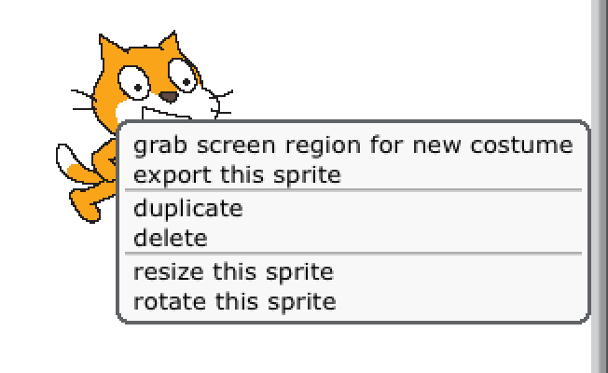
Today we do not need our friendly scratch cat so right click on it and select delete. If you have a mac press CTRL and click.

Slide 5
Instead of the cat lets draw a new sprite. A sprite is a picture that will be used in todays program.
Click on the ‘new sprite button’ with the paintbrush on it.

Slide 6
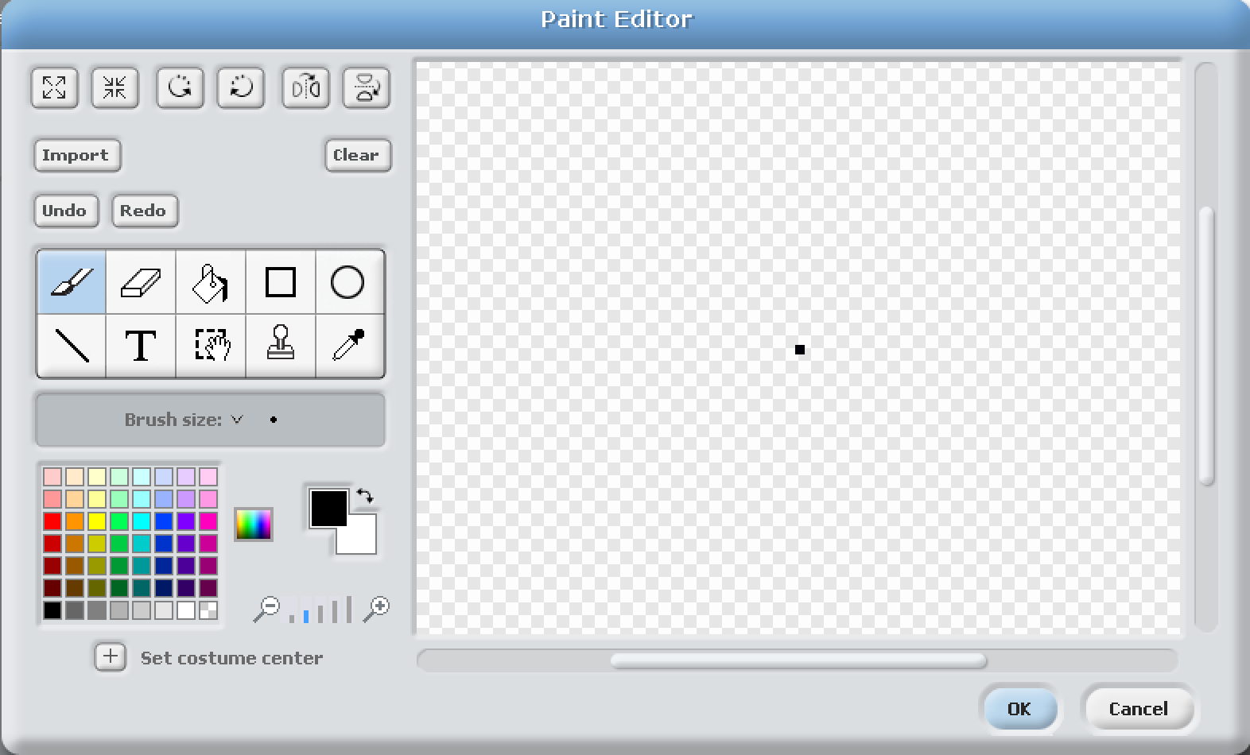
Place a single dot in the middle of the screen and click OK.
If it goes wrong you can always click cancel and do it again.

Slide 7
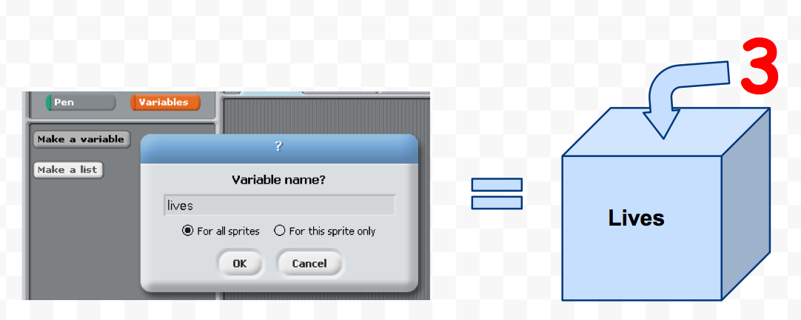
Now we will create some variables. Think of a variable as a box you can put things like numbers into. If we create a variable called ‘lives’ then we could put the number 3 into it so we can check on it later.

Slide 8
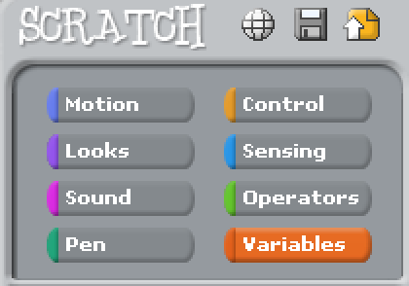
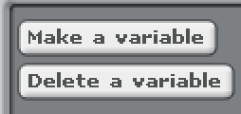
Click on the variable button in the top left of your screen. If you have a later version of Scratch - this might be called ‘data’.
Click on the ‘make a variable button’

Slide 9
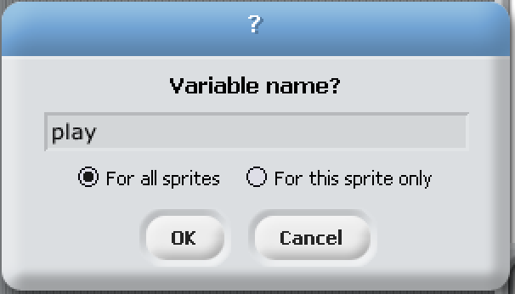
Lets call this one ‘play’
Click on OK

Slide 10
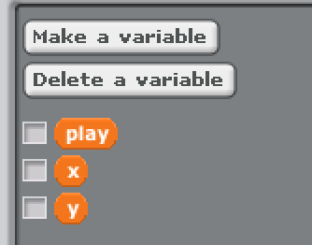
Click on the ‘make a variable’ button again and create another one called ‘x’ and one more time to make one called ‘y’
Remove the ticks from next to them so they
are not on the main screen area

Slide 11
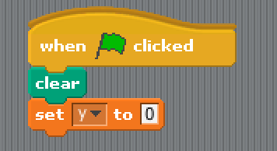
Now we need some code to make something happen.
You can start with the ‘set y to 0’ as that should be on the screen already. Pick it up and drop it in the middle area.
It may say one of the other names like ‘play’ the little black arrow lets you change it.
You will find the ‘when flag clicked’ under control and the ‘clear’ under pen.

Slide 12
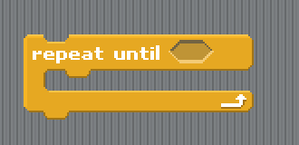
Next we need a loop.
A loop will repeat the commands inside it over and over again. This could be - Repeat ‘play’ until tired or Repeat ‘eat’ until you are not hungry. Find this loop that says ‘repeat until’ under the control section and drag it into the middle.

Slide 13
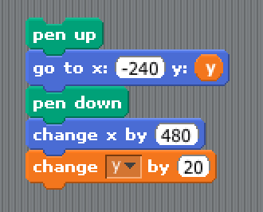
Lets get some drawing done. You will find the ‘pen’ command under pen, The blue commands are under motion and the dark orange one is under variables.
Where you see white boxes you need to change the values by clicking in the box and typing them.
See the orange ‘Y’ on the second line. That is also in variables so just pick it up and drop it in place.

Slide 14
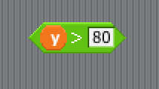
Under the command section you will find these. This one (with the arrow pointing to the right) means greater than. Drop another ‘y’ into the left side and type the number 80 into the right.
It now says ‘if Y is GREATER THAN 80’

Slide 15
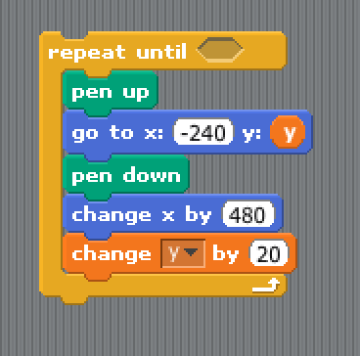
Lets stick it all together. Pick up the big block by dragging the top command ‘pen up’ and drop it inside the loop. Dont worry it will expand to be big enough to fit.

Slide 16
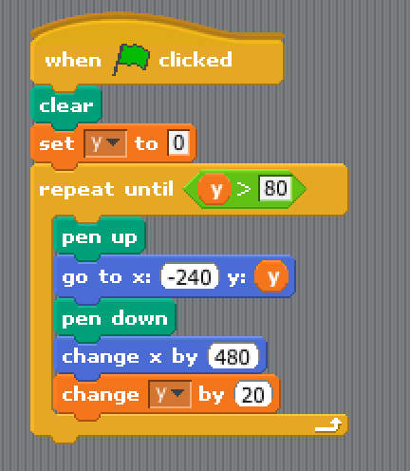
Now attach the loop onto the bottom of the green flag part
and put the ‘y > 80’ part in the hole next to repeat until.

Slide 17
It is a good idea to save now and then so you can always go back if it gets messed up or even goes wrong and crashes.
Click ‘save’ icon and type in a name.
Lets call this one tunes

Slide 18
Lets try it. Press the green flag at the top right. What happens ?
?

Slide 19
We need another sprite now. Click on the new sprite button with the brush again.

Slide 20
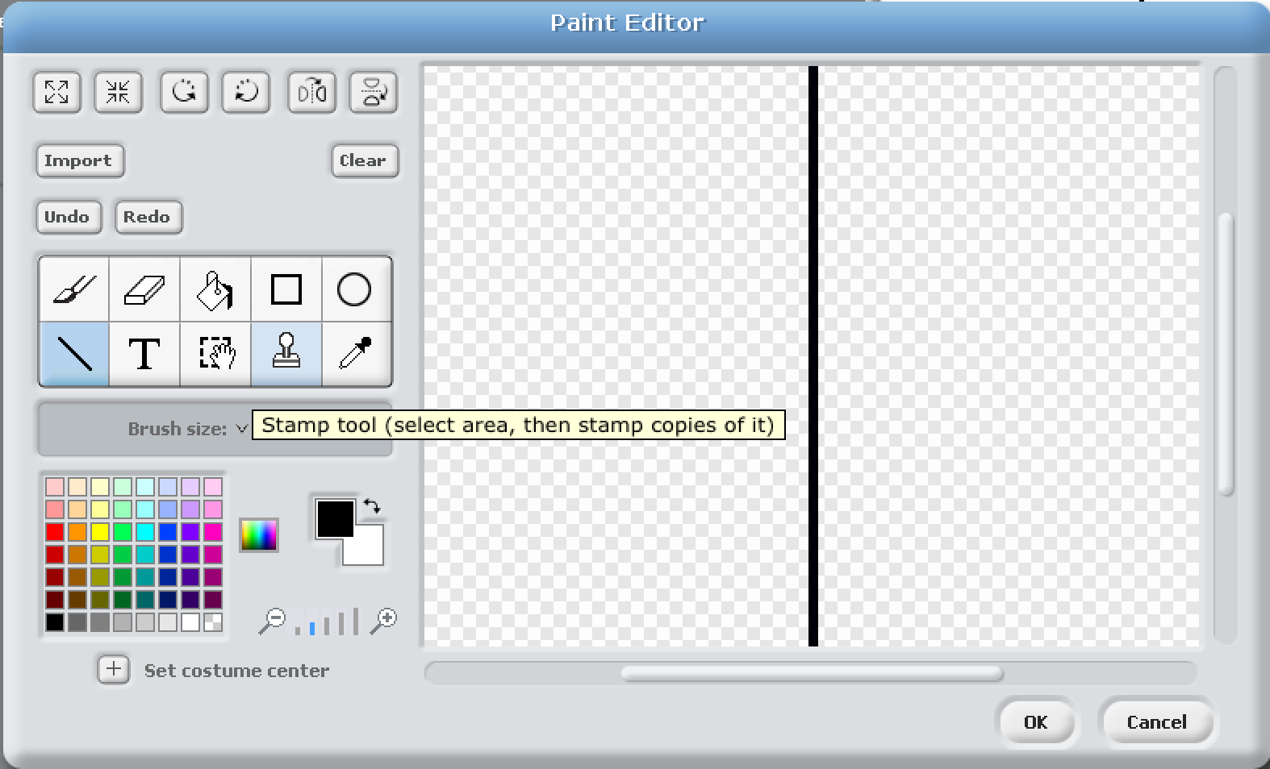
Using the line tool (see where I am pointing on the left) draw a line from the middle of the top down to the middle of the bottom. Make sure it is straight. If it goes wrong just hit cancel.

Slide 21
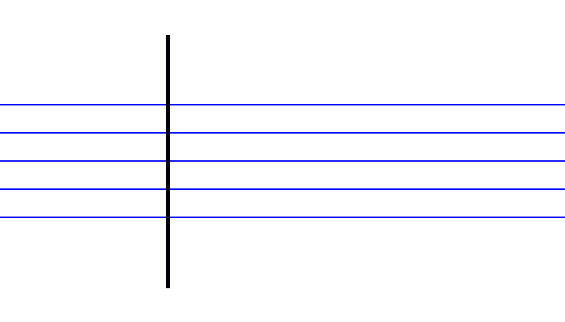
After you have pressed ‘OK’
place the line over the other lines - like this :

Slide 22
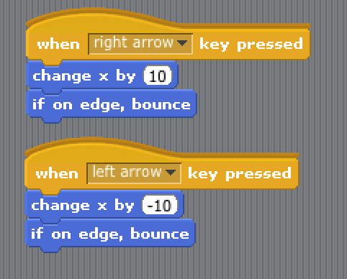
Make sure the line is still selected down at the bottom right
and add some code to tell the line what to do.
The orange bits are in control and the blue bits are under motion.
You will need to type in the numbers ‘10’ and ‘minus 10’

Slide 23
What do your left and right keys do now ? Why ? What do the up and down keys do ? Why ?

Slide 24
Time for another sprite :

Slide 25
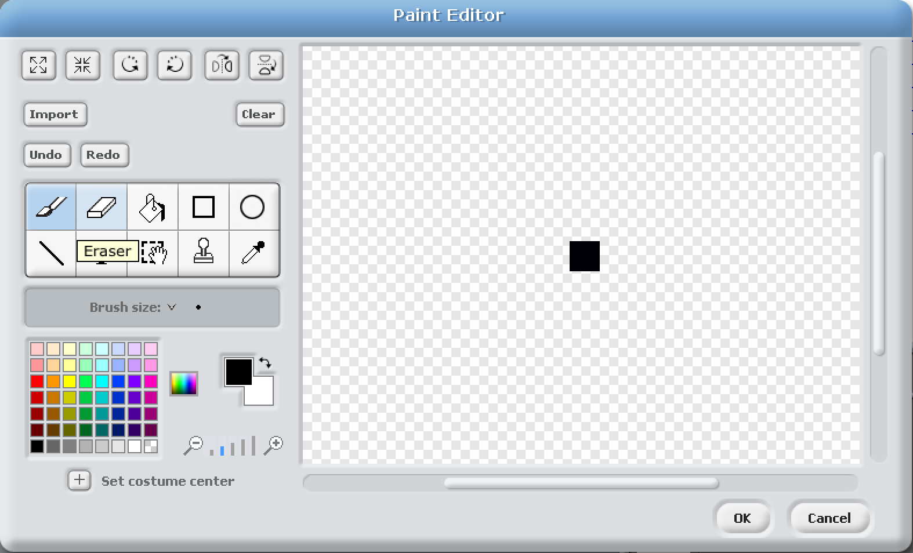
Make this one a bit bigger than the last dot. Maybe three dot by 3 dots
make it quite close to the centre of the screen.

Slide 26
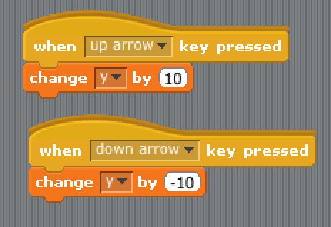
And lets give this new sprite some code to move about too.
The ‘change y’ commands are in the variables section.

Slide 27
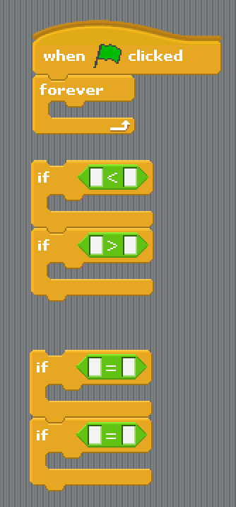
Most of these are in control. The green ones are in operations.

Slide 28
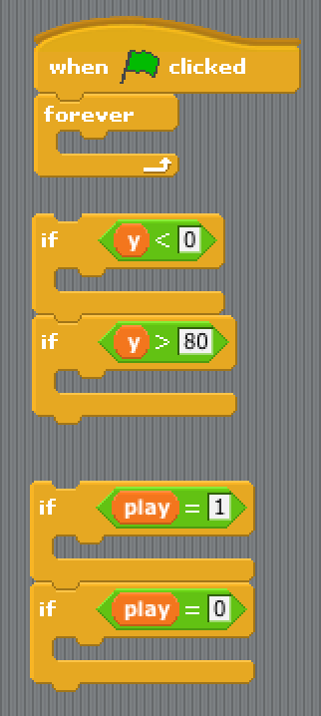
We need some variables on the left to check and you type in the numbers on the right.

Slide 29
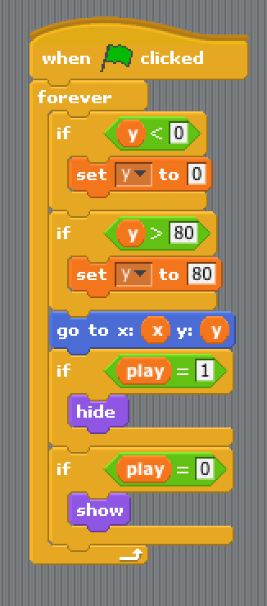
There are a few more bits to add - take your time… Orange bits are in variables. Blue in motion and Purple in pen.

Slide 30
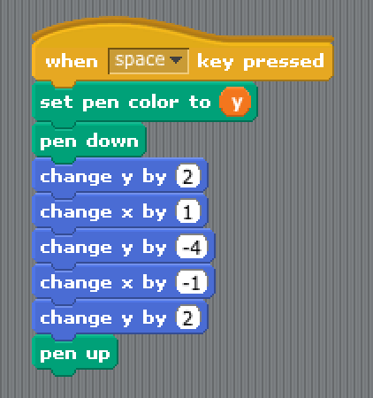
Now add a new bit of code. It goes into the same middle section.
When you get the ‘set pen colour’ command use the one that says ‘0’ not the one with a colour blob.
Remember to put in the values and make sure you get the Blue bits in the right order ‘y x y x y’

Slide 31
Click on the line in the bottom right corner.
We need some code for the line now :

Slide 32
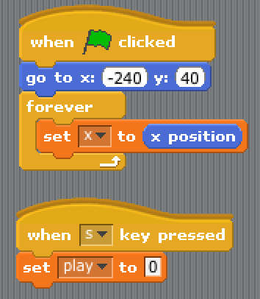
More code… again drag the bits into the middle and put them together. If you need more room you can move up or down using the arrow on the right hand side of the middle area.

Slide 33
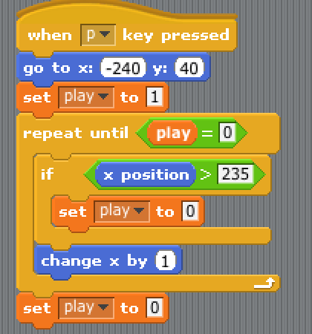
More code ? Will this ever end ?

Slide 34
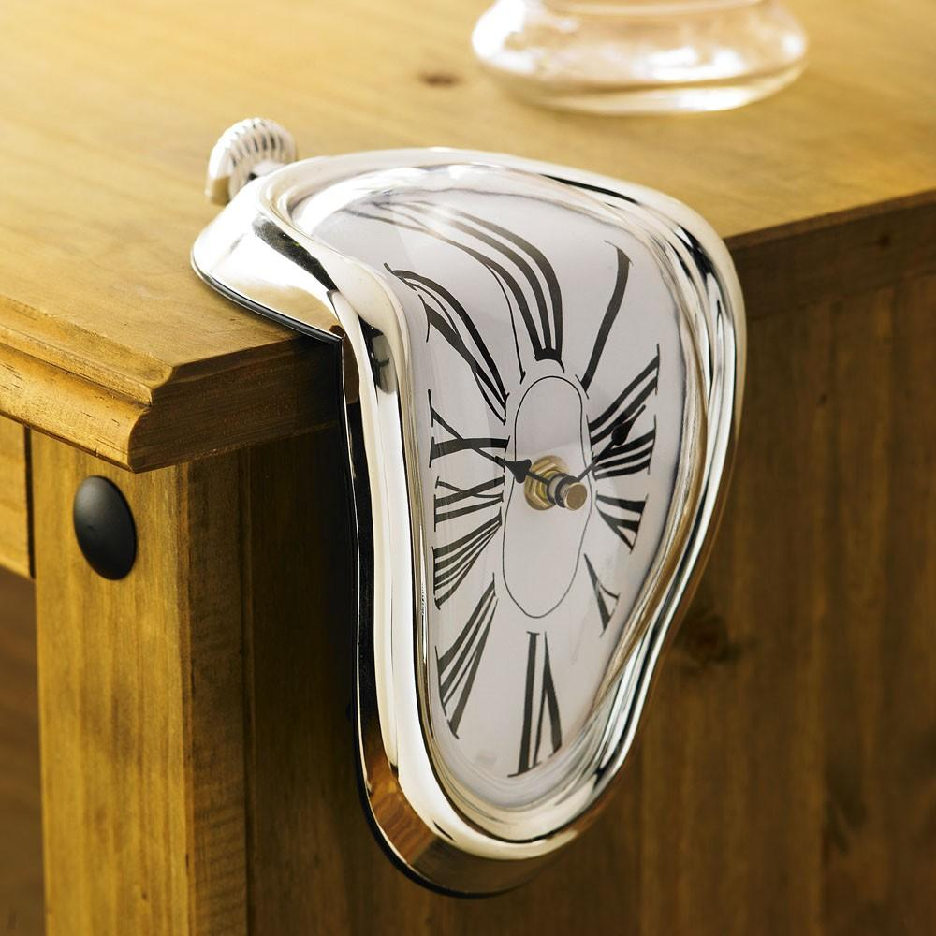
Break time… take 5 minutes. Rest your eyes, legs, fingers and all that.
Have a drink and a snack - keep up the energy levels
That was a lot of coding work…. we are almost there now

Slide 35
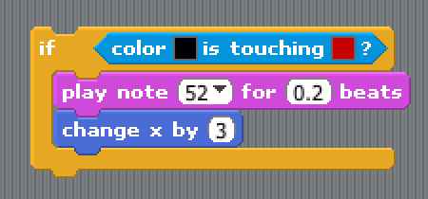
You should still be in the line. Make up this bit of code. Dont worry about the colours for the moment.
Just get the numbers right.
We need 9 of these so right click (if you have a mac CTRL + click) and select duplicate. Repeat until you have 9 blocks just like this one.

Slide 36
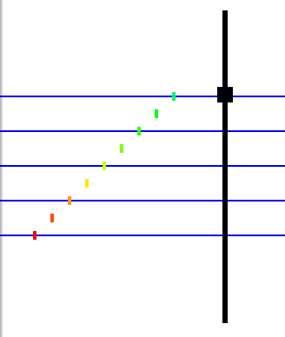
Run the program (by clicking the green flag) and move about.
Place a dot on the lowest line by pressing the space bar.
Now move up and over a bit and place another dot in the space between the lines and now on the next line...and all the way like this to the top

Slide 37
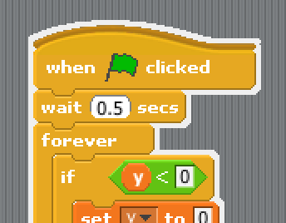
If your big dot will not move up and down
add in this one statement to the Big dot sprite code.
Then switch back to the line code again.
That should fix it.

Slide 38
Run the program (by clicking the green flag) and move about.
Place a dot on the lowest line by pressing the space bar.
Now move up and over a bit and place another dot in the space between the lines and now on the next line...and all the way like this to the top

Slide 39
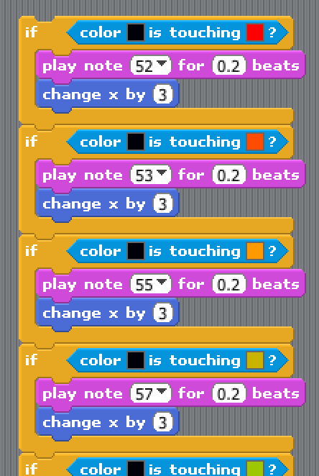
On the top block that you made a minute ago, click on the colour on the right and now click on the dot that you just put on the bottom bar If it goes ‘white’ you missed :) Try it again until it goes red.
Repeat this for all of them :

Slide 40
Now we need to change the note number. The top one is 52
then 53, then 55, then 57, then 59,
then 60, then 62, then 64 and finally 65.

Slide 41
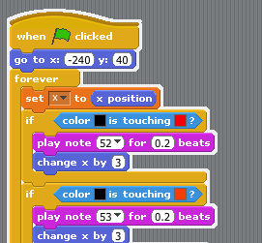
Put all these blocks together and put them inside the bit of code you have already with the green flag. Put them under the ‘set x’ bit

Slide 42
Phew - that was hard work. But guess what….. its testing time. Press the green flag to start (or clear the screen). Arrow keys move round. P key plays what you have put down and S key stops

Slide 43
What have we used today ?
Loops
Variables
‘If’

Slide 44
Thats it - you have just coded your first application. A music maker !
Does that make you a CoderDojo Ninja ?

Slide 45
No.

Slide 46
A CoderDojo Ninja is someone who takes it further and
makes it into their own unique application.
Some ideas :
* What about different noises ? Look for ‘change Instrument’
* What about drums ?
* Better graphics ?
* Write me some music - I want to hear it !
* and most important… add your own ideas...

Slide 47
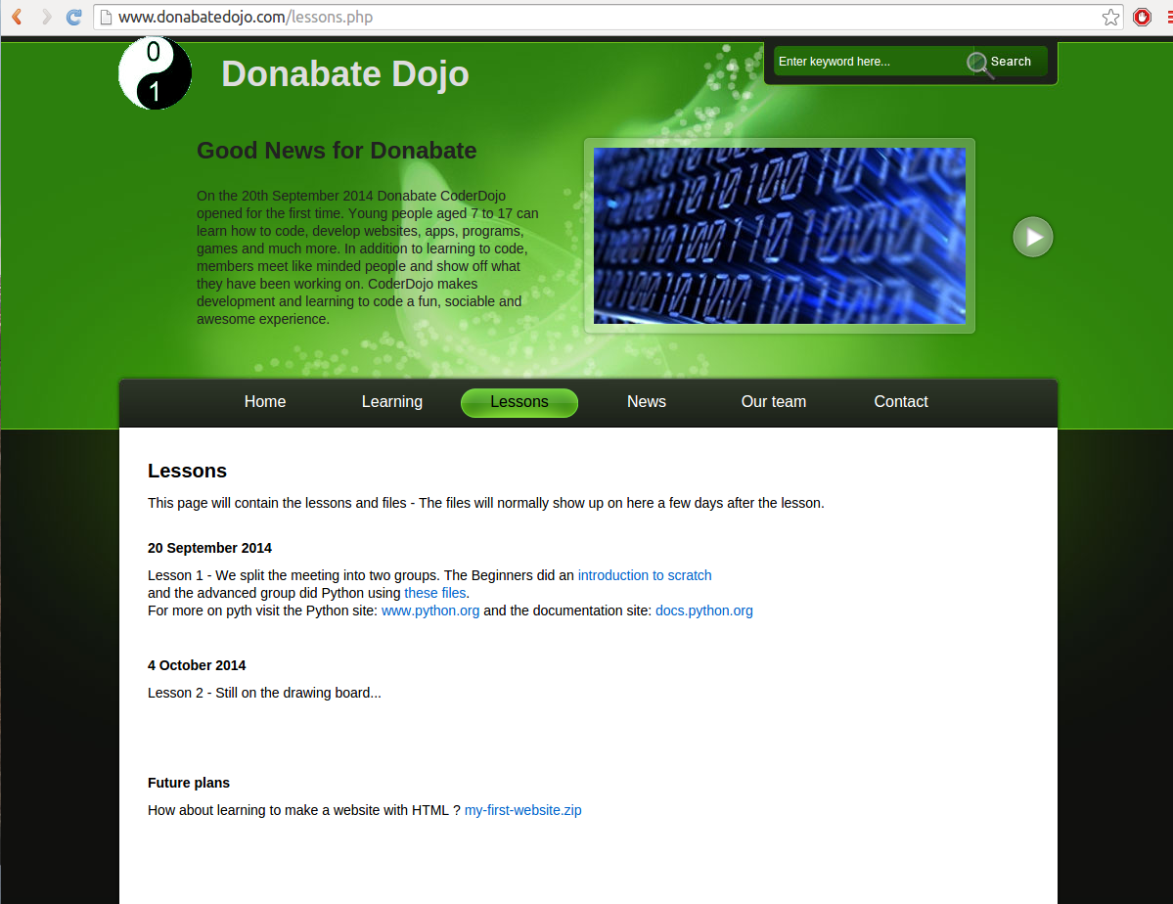
Did you miss any steps ? This presentation is available on our website : www.donabateDojo.com
Click on ‘lessons’

Slide 48
A big thank you to
The Donabate Dojo Mentor team.
The Community Centre for the room and setting it up.
The mums and dads and adults for transport and help
and most of all - Thank you to our new Ninjas (thats you)
Comments, suggestions, donations, questions to :
email : team@donabateDojo.com
Facebook : www.facebook.com/DonabateDojo
Twitter :@DonabateDojo
Website : www.donabateDojo.com

